Slide 1

How We
Are Affected by Price

Slide 2
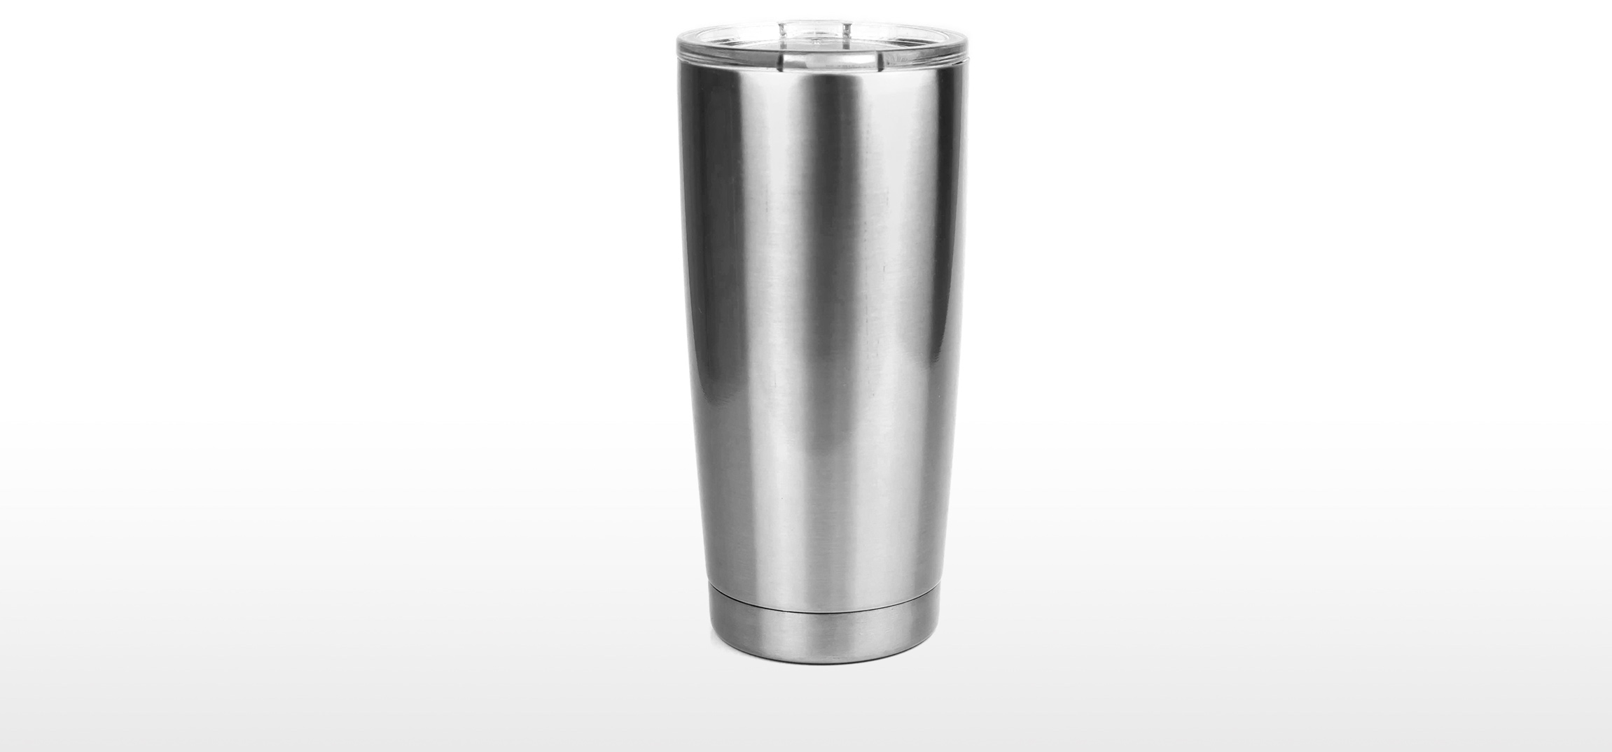
Name the Price
Notes:
Instructor Notes:
Present students with the following hypothetical scenario: A club at your school is considering selling items as a fundraiser. They have asked your class to advise them on how much they should charge.
Let students know that you will be handing out a slip of paper with the information that was provided to you. Tell them to read it and fill in the information.
Distribute a section from Name the Price to each student. As you pass out the slips of paper, do not draw attention to the fact that there are different versions being given to students at random.
Collect the completed slips from the students.
Ask several students to share the price they wrote on their slip of paper and why they selected it.

Slide 3
Group | Scenario
A | The item to be sold is a 20 ounce thermal tumbler. It comes in stainless steel or colors. Our plan is to have both the stainless steel one and one in our school colors. It will have the logo on it. There is a flip top lid so that drinks won’t spill. We have asked other schools, and they are selling similar tumblers for about $19.
B | The item to be sold is a 20 nce thermal tumbler. It comes in stainless steel or colors. Our plan is to start with the stainless steel one and add the school logo in color. If we order 24 of them, we can get them for $11.49 each with the logo. If we order 100, the price drops to $9.56. There is also a $40 setup charge for the logo. They are currently running a special with free shipping.
C | The item to be sold is a 20 oune thermal tumbler. It promises to keep beverages hot for 8 hours or cold for at least 12. It comes in stainless steel or colors. Our plan is to have both the stainless steel one and one in our school colors. A very similar name brand tumbler costs $29.99.
D | The item to be sold is a 20 ouncethermal tumbler. It promises to keep beverages hot for 8 hours or cold for at least 12. It comes in stainless steel or colors. Our plan is to have both the stainless steel one and one in our school colors. There is a flip top lid so that drinks won’t spill, as well.
The item to be sold is a 20 ounce thermal tumbler. It comes in stainless steel or colors. Our plan is to start with the stainless steel one and add the school logo in color. If we order 24 of them, we can get them for $11.49 each with the logo. If we order 100, the price drops to $9.56. There is also a $40 setup charge for the logo. They are currently running a special with free shipping.
B
The item to be sold is a 20 ounce thermal tumbler. It promises to keep beverages hot for 8 hours or cold for at least 12. It comes in stainless steel or colors. Our plan is to have both the stainless steel one and one in our school colors. A very similar name brand tumbler costs $29.99.
C
The item to be sold is a 20 ounce thermal tumbler. It promises to keep beverages hot for 8 hours or cold for at least 12. It comes in stainless steel or colors. Our plan is to have both the stainless steel one and one in our school colors. There is a flip top lid so that drinks won’t spill, as well.
D
Notes:
Instructor Notes:
Reveal that there were four different scenarios provided to the students.
Click to reveal one scenario at a time. Ask students to raise their hands to determine who had each scenario.
Direct students to gather in separate areas in the room with the students who had the same scenario they had. Invite them to discuss the prices they wrote down and their reasons.
While students are talking, sort the slips of paper by the scenarios. Give each group the responses for another group. For example, the group who responded to scenario A could receive the responses from scenario D.
Invite students to review the responses and determine:
The lowest price given
The highest price given
The average or mean response (Optional: Provide a calculator so students can total the answers and divide by the number of responses.)
Challenge students to consider whether the average price given by students with the other scenarios will be higher or lower than the one they calculated and why.

Slide 4
Group | Scenario | Lowest Price | Highest Price | Average Price
A | The item to be sold is a 20 ounce thermal tumbler. It comes in stainless steel or colors. Our plan is to have both the stainless steel one and one in our school colors. It will have the logo on it. There is a flip top lid so that drinks won’t spill. We have asked other schools, and they are selling similar tumblers for about $19.
B | The item to be sold is a 20 ounce thermal tumbler. It comes in stainless steel or colors. Our plan is to start with the stainless steel one and add the school logo in color. If we order 24 of them, we can get them for $11.49 each with the logo. If we order 100, the price drops to $9.56. There is also a $40 setup charge for the logo. They are currently running a special with free shipping.
C | The item to be sold is a 20 ounce thermal tumbler. It promises to keep beverages hot for 8 hours or cold for at least 12. It comes in stainless steel or colors. Our plan is to have both the stainless steel one and one in our school colors. A very similar name brand tumbler costs $29.99.
D | The item to be sold is a 20 ounce thermal tumbler. It promises to keep beverages hot for 8 hours or cold for at least 12. It comes in stainless steel or colors. Our plan is to have both the stainless steel one and one in our school colors. A very similar name brand tumbler costs $29.99.
Notes:
Instructor Notes:
Let students know that you are going to compare the responses given by each group. If desired, distribute a copy of the Name the Price Summary Information to each student.
Invite a member of each group to share the lowest, highest, and average price for the responses they reviewed.
Fill in the table on the screen and/or direct students to complete their own paper copies.
Discuss similarities and differences in the answers and invite students to offer an explanation for the patterns they observed.

Slide 5
What factors influenced the price you gave for the tumbler?
$
$
Notes:
Instructor Notes:
Lead a discussion about the factors that influenced the prices students provided. Possible factors might include:
Desire to make a profit from the sale (especially scenario B)
Product features (especially scenario C)
Familiarity with the product and price (especially scenario C)

Slide 6
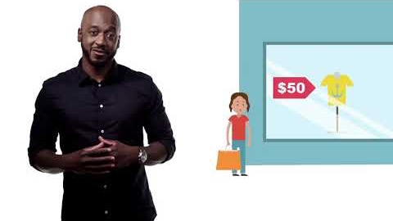
Notes:
Instructor Notes:
Play the video.
Invite students to suggest how anchoring could have played a role in the prices each group provided in the opening exercise. If needed, refer back to the average price for each scenario.

Slide 7
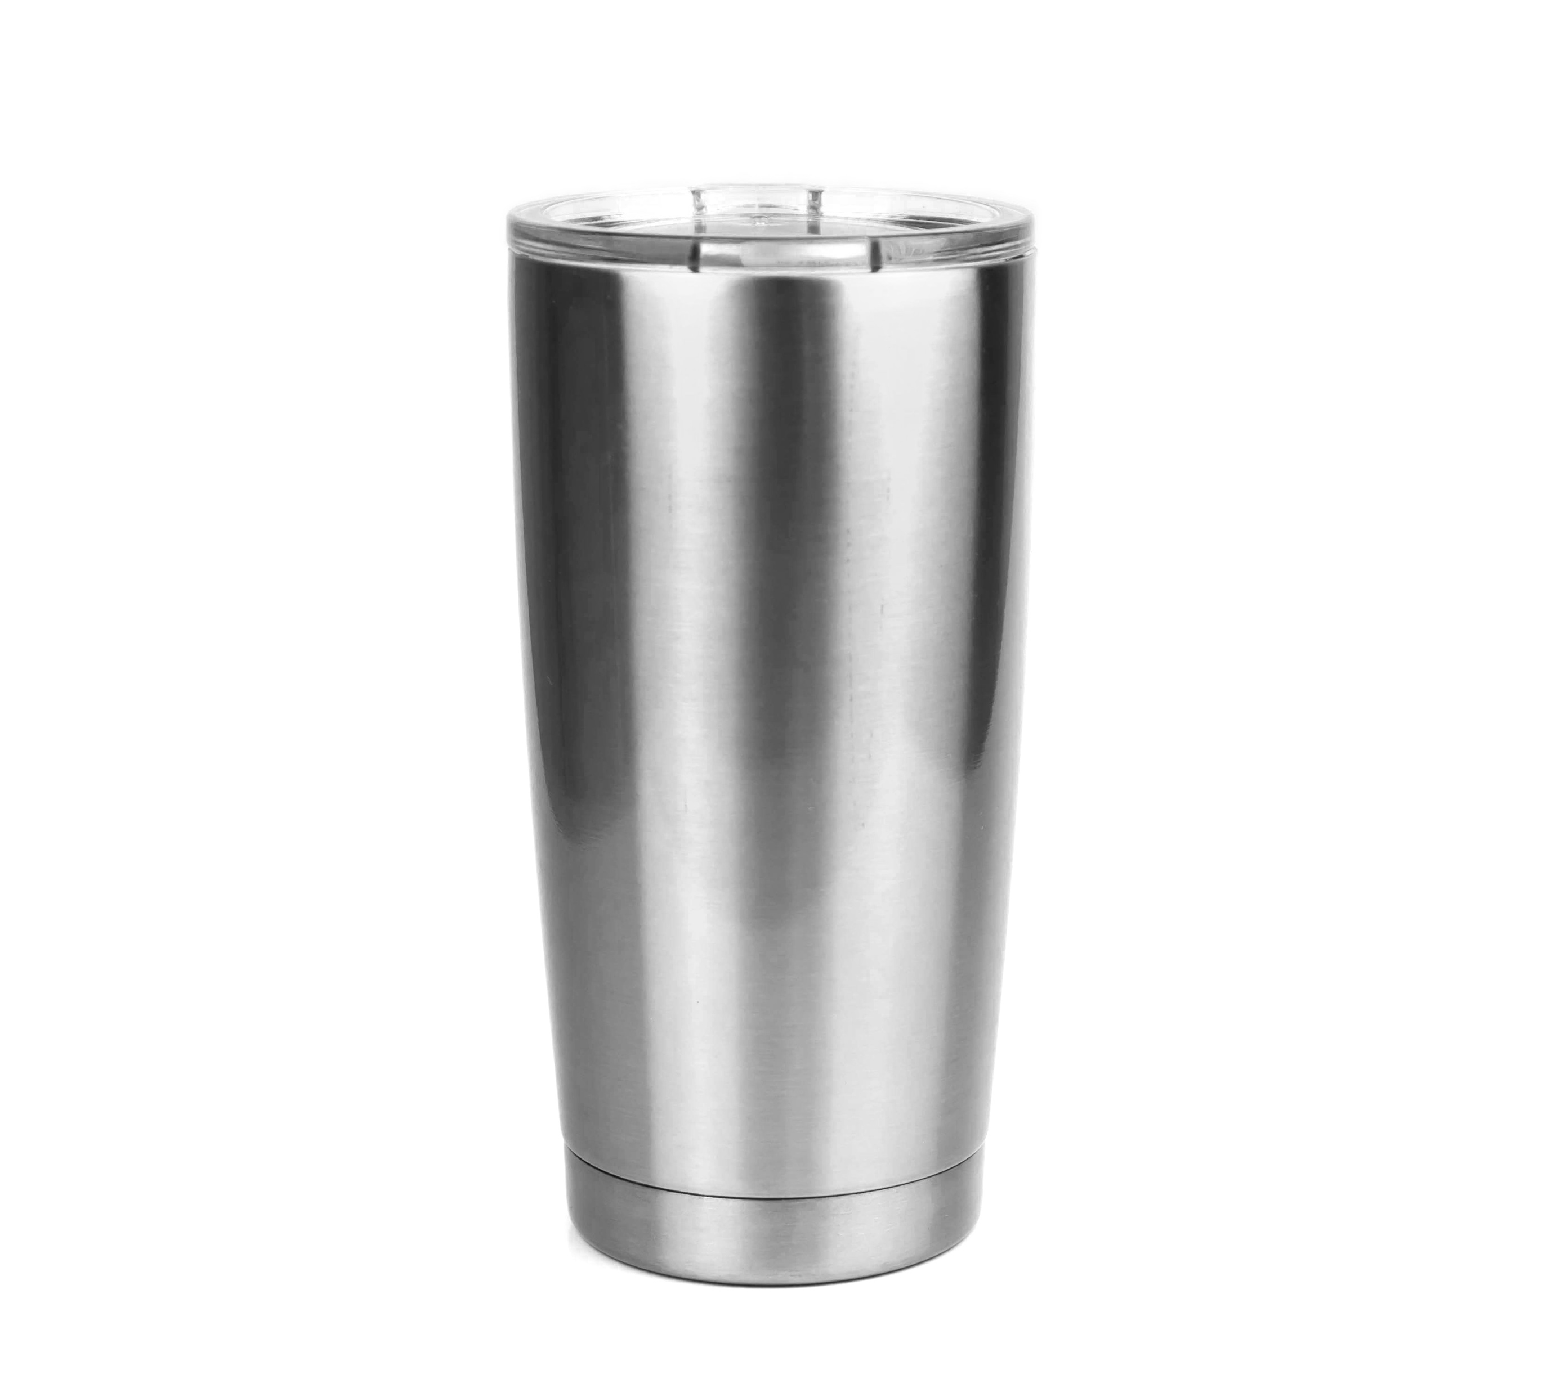
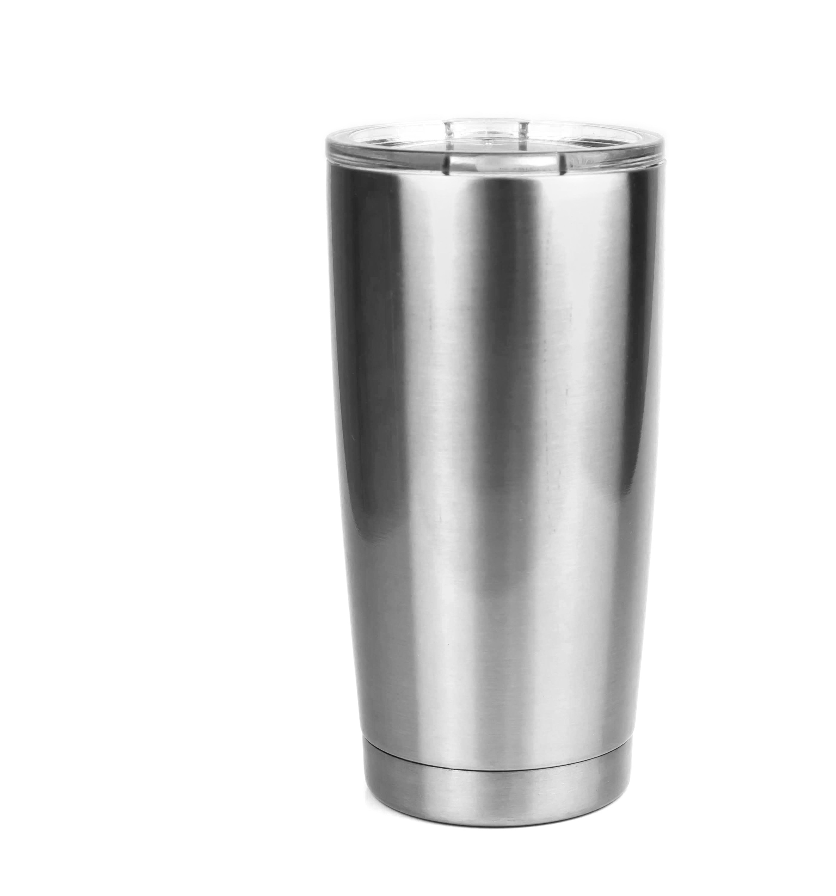
A:
Other schools selling similar tumblers for about $19
C:
Similar tumblers $29
$19
$25
B:
Cost $11.49 to $9.56
D:
No price information
is given
$10
?
Notes:
Instructor Notes:
Share that behavioral economists have performed numerous versions of this experiment. In nearly every case, when prices are provided, the responses tend to be closer to the amount provided than when no price is given.

Slide 8

Assigning Value in the Absence of Price
Notes:
Instructor Notes:
Tell students that you are going to do a short activity in which they come up with the price of a good or service. You are going to give each of them a description, and no one will be given any price or anchor. If they are a buyer, they will write down the price they would pay for the good or service. If they are a seller, they will write the price they would request. Let students know that it is okay to guess at a price if they are uncertain.
Distribute a card from Buyers and Sellers to each student. It is okay if more than one student gets the same card, just make sure that each buyer has at least one corresponding seller. If needed, take a card for yourself to even out the pairs/groups.
Once students have answered the question, direct them to find the other buyer(s) and/or seller(s) with the description that matches theirs. A total of six groups should be formed.
Ask each group of buyers and sellers to compare the prices they provided. Invite a volunteer from each group to share whether the prices were similar or different and by how much.
Challenge students to rank the goods or services from easiest to price to hardest to price.

Slide 9

Anchoring and Prices
Anchors tend to impact people __________ when they do not know how to value the item or service.
more
Notes:
Instructor Notes:
Read the statement aloud and ask students how they would complete the sentence and why.
Click to reveal the correct answer, “more.” Explain that people generally have a harder time putting a price on items with which they are unfamiliar. For example, students are likely to have a harder time coming up with a realistic price for a home since this is a good which few students are familiar.

Slide 10

Anchors and Consumers
How can companies or marketing influence a consumer’s choice by providing an anchor?
Does an anchor price always hurt a consumer? In what ways could it help?
Notes:
Instructor Notes:
Engage students in a conversation about how a business or company providing consumers with a price as an anchor could influence the consumer. Prompt students with the questions shown on the slide.

Slide 11
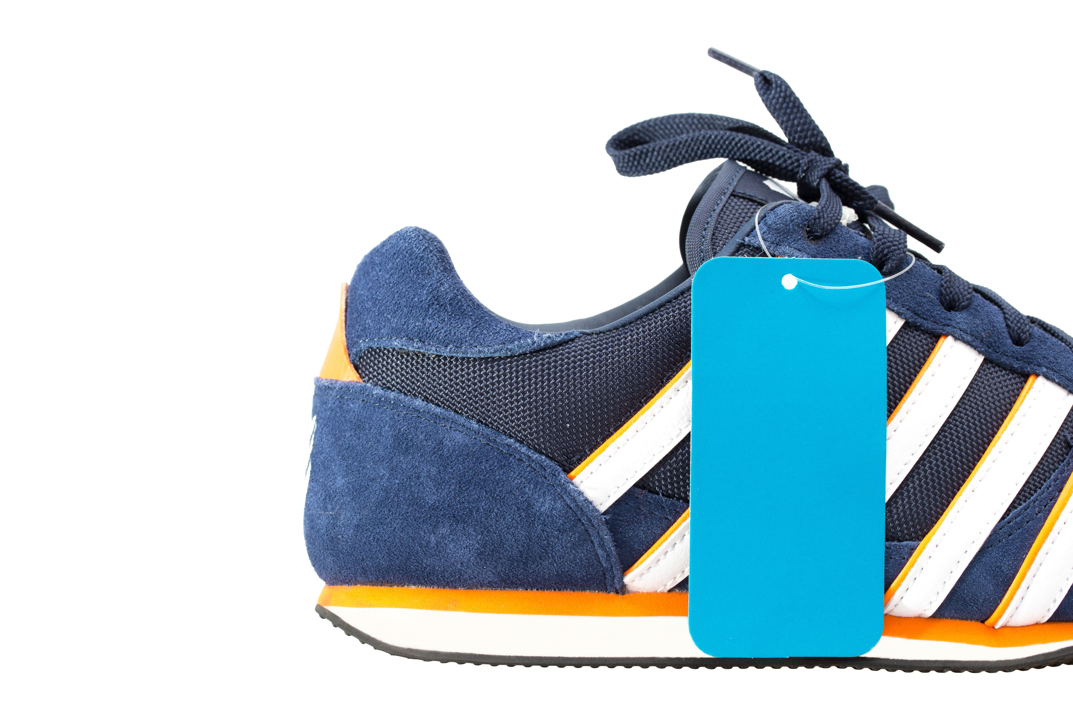
Anchors and Consumers: An Example
Imagine you see a pair of shoes for sale at a store for a high price. Let’s say they are $200.
Shortly after that, you see the same exact shoes for a much lower price of $75. What is the effect on you as a consumer?
Notes:
Instructor Notes:
Tell students you want them to consider an example of anchoring and how it could impact a consumer.
Click to share the scenario. Point out that they have been presented with an anchor price for the shoes of $200.
Click to provide the rest of the scenario. Ask students to respond to the question. Discuss possible reactions. In most cases, consumers who see a high price anchor and then see a lower price view the second price to be a “deal” and are more inclined to want to buy them.
Challenge students to consider how this knowledge could be used by companies to influence people to buy items.

Slide 12

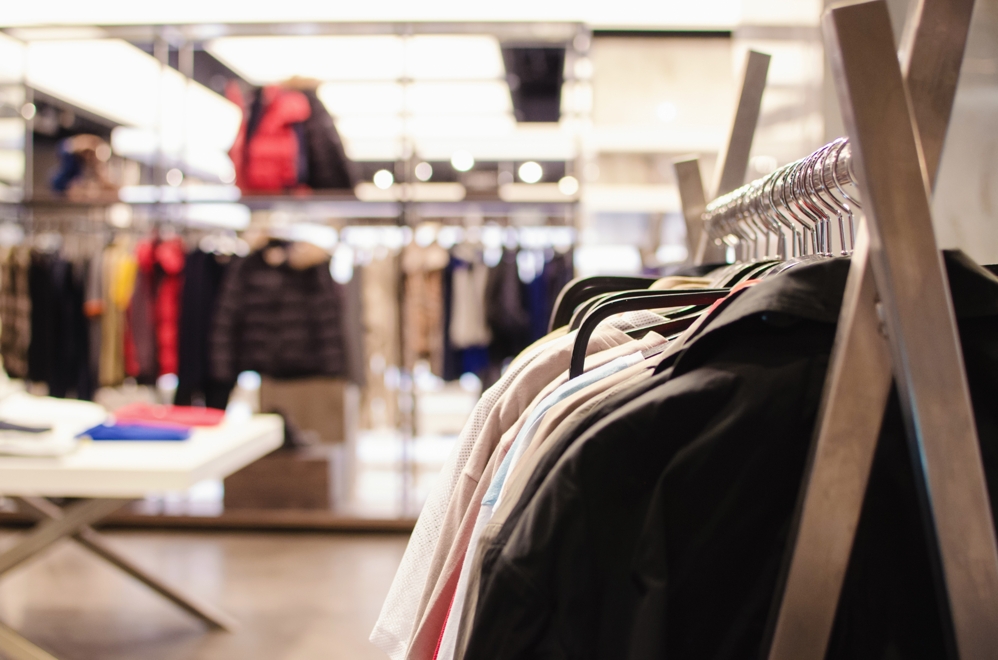


Anchoring (and more) in Action
Select a scenario.
Notes:
Instructor Notes:
Inform students that they will be breaking into groups to consider various scenarios in which behavioral economic concepts dealing with price might influence a person’s decision.
Let them know you will preview the four scenarios and let them create small groups with others who wish to explore the same topic.

Slide 13
Scenario 1
Negotiating a Price
Consider how anchoring impacts negotiating a price.
Scenario 2
JCPenny’s failed pricing strategy
Find out what happened when a store changed its pricing.
Notes:
Instructor Notes:
Briefly introduce scenario 1.
Click to show and then describe scenario 2.

Slide 14
Scenario 3
The Price of the First iPad
How much did the first iPad cost?
Scenario 4
Freemium Pricing
What happens when services or apps are free with the option for a premium, paid version or extras?
Notes:
Instructor Notes:
Share scenario 3.
Click to show and then describe scenario 4.
Direct students to form small groups. It is okay if more than one group selects the same scenario.
Distribute scenario descriptions from Anchoring (and more) in Action to each group. Share your expectations regarding time to complete the activity and plans to share results with the class.

Slide 15
Anchoring (and more) in Action
Share what you learned.
Notes:
Instructor Notes:
Invite each group to share what they learned and discovered.
Engage students in a discussion of each scenario after all groups with that topic are done presenting. Reference the Anchoring (and more) in Action Facilitation Guide for additional insight on each scenario.

Slide 16
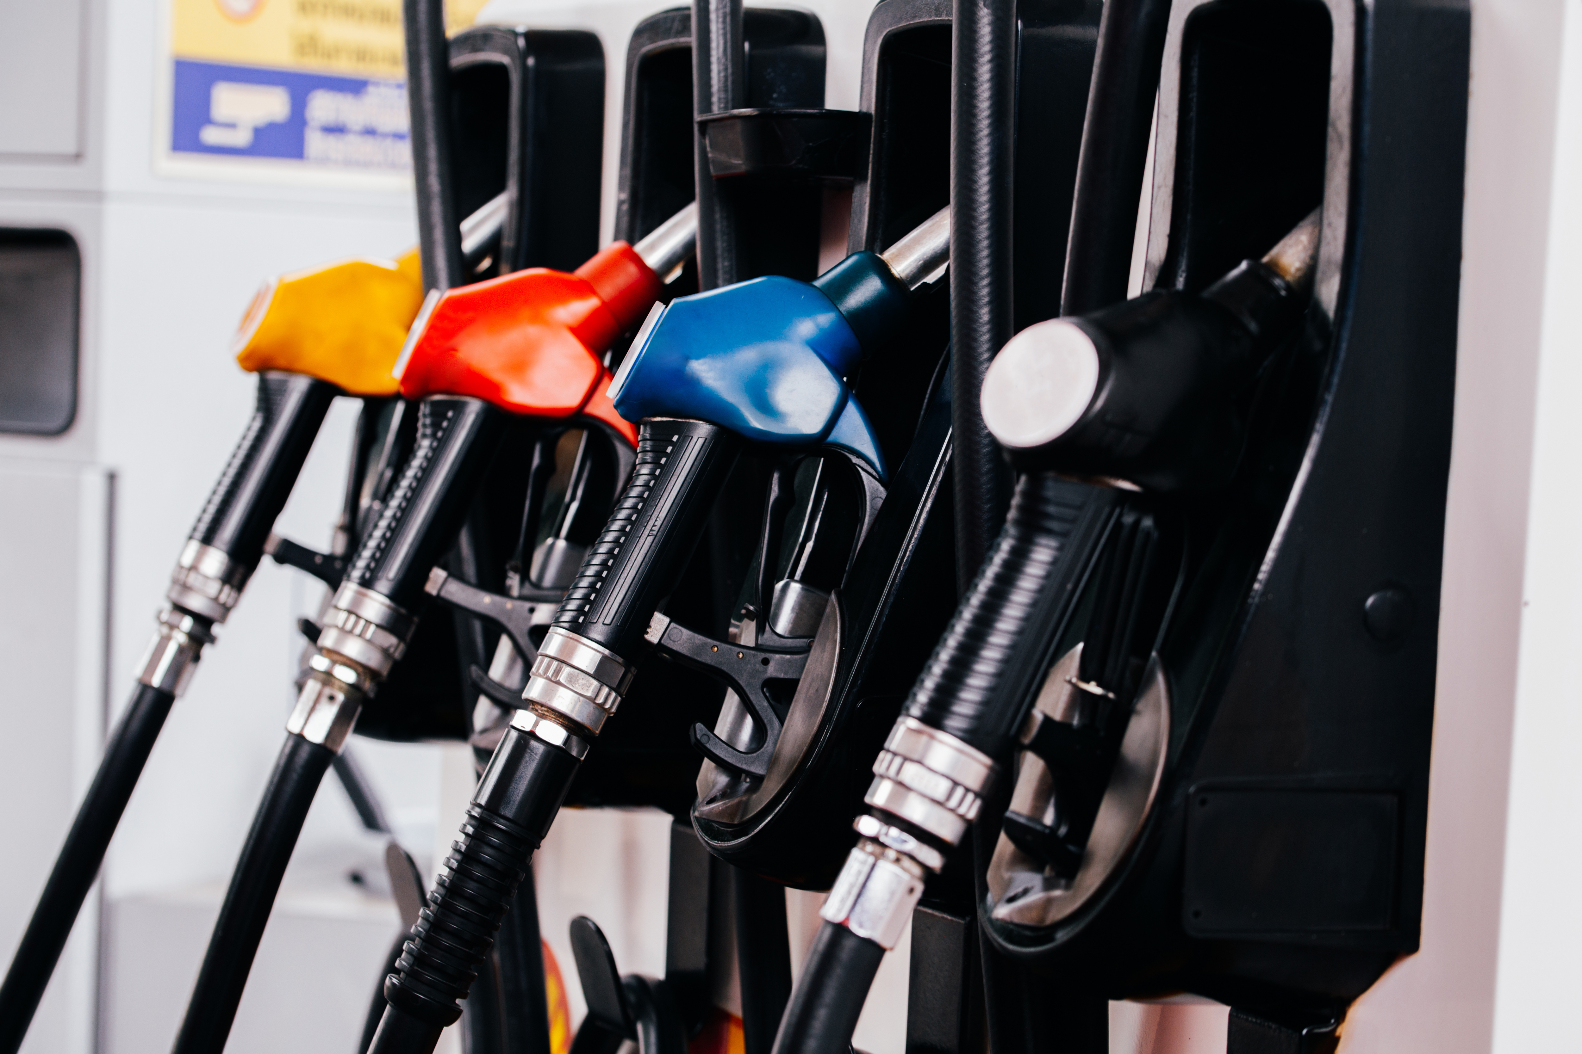
How much does a gallon of gas cost?
Notes:
Instructor Notes:
Ask students how much a gallon of gas costs in your area. Students who drive will likely be able to answer this question more easily than those who do not. An easy way for students to locate current gas prices is to conduct a Google search using “gas prices near me.”
Invite students to describe whether they think current gas prices are high, low, or about average and justify their responses.
Let students know that you did not provide them with a picture of a gas price sign on purpose. You also did not ask if they thought the current price was higher or lower than a certain amount. Challenge students to explain this purposeful choice.
Remind students about what they learned in previous sessions about anchoring and let them know you did not wish to influence their responses by providing an anchor.

Slide 17

Gas Prices Around the Nation
Notes:
Instructor Notes:
Inform students that gas prices often vary depending on where you live in the country. You can find out the prices from a number of sources, including AAA and GasBuddy.
Click on each image, one at a time, and show students the maps which are displayed.
Invite students to pair with a classmate and examine one of the maps provided or similar one of their choosing.
Direct them to do one of two things:
Draw at least two conclusions about gas price trends in the country.
Develop a plausible scenario in which a person might have an opinion or make a decision based on gas prices.
If needed, provide an example, such as, “If I lived in _____ and visited ____, I would think the gas prices are much higher. If so, I might _____.”
Allow time for several volunteers to share what they found.

Slide 18

Notes:
Instructor Notes:
Tell students that gas prices don’t just vary regionally, they can also change quite a bit over time. Some changes can happen very quickly, while others are more gradual. Current events, for example, can have an impact on gas prices.

Slide 19
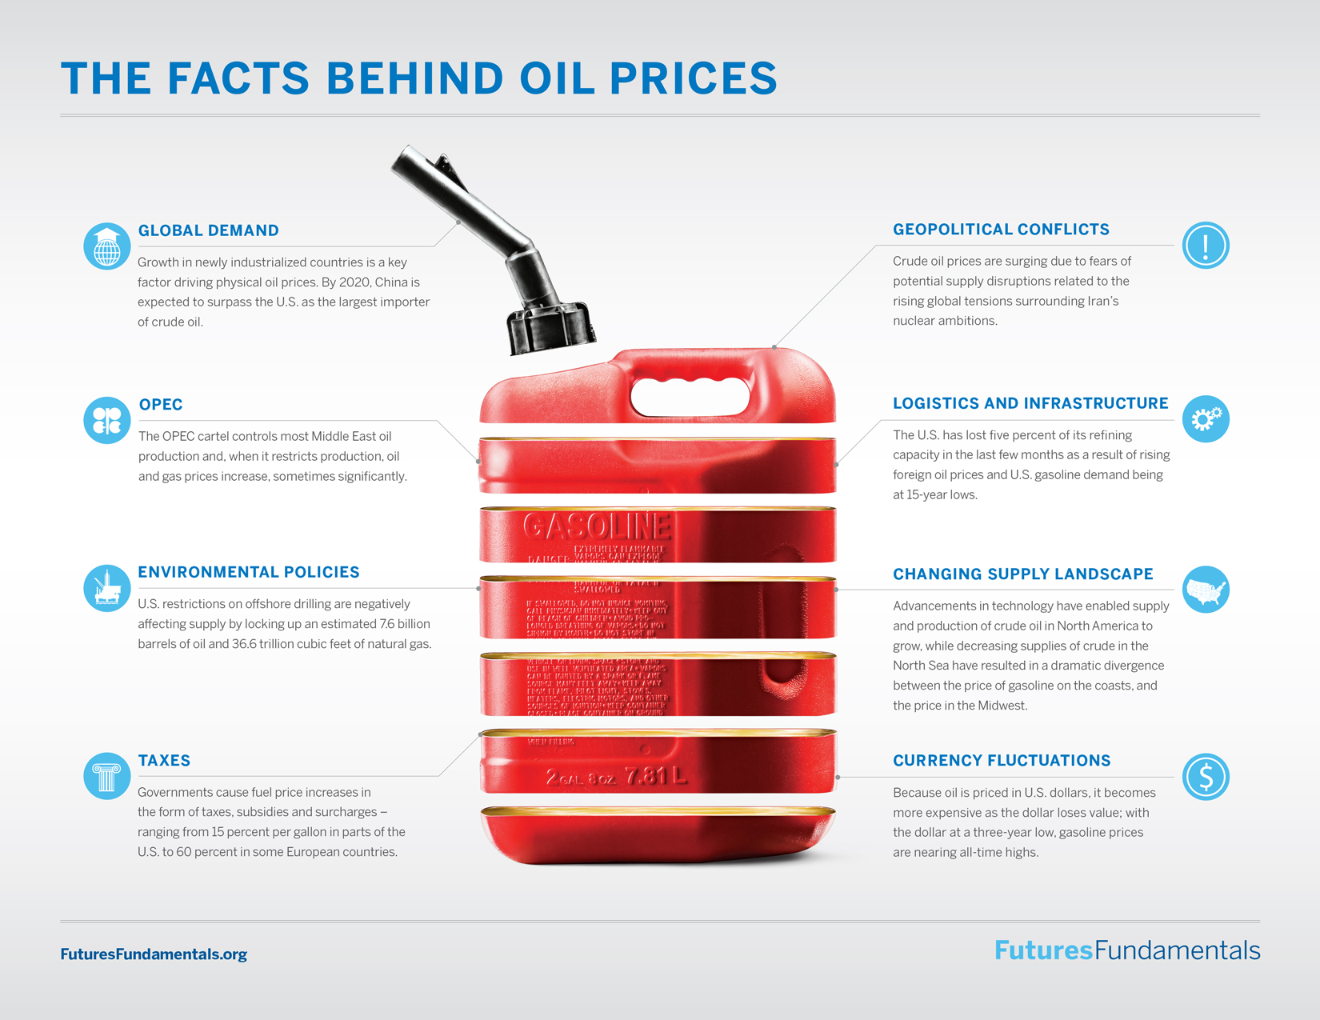
Notes:
Instructor Notes:
Explain that many more factors can influence gas prices.
Distribute a copy of The Facts Behind Oil Prices to each student.
Inform students that you are going to play a video about gas prices. Direct them to use The Facts Behind Oil Prices handout to take notes during the video. Ask them to identify costs as they are explained.

Slide 20
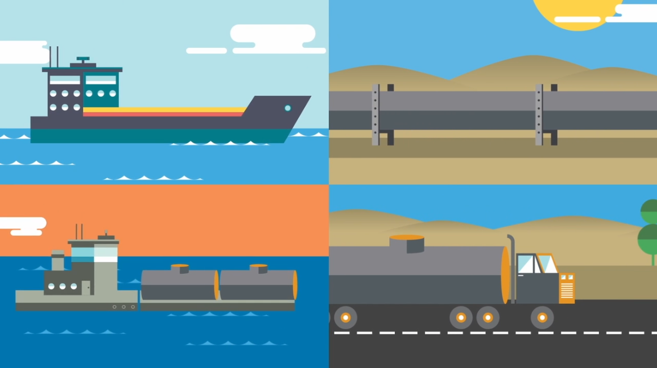
Futures
Spotlight
Notes:
Instructor Notes:
Click to play the video (approximately 5 minutes).
Challenge students to consider how price and behavioral economic concepts influence various market participants. In particular, ask students to consider how anchors might impact hedgers and speculators.
Note: Students might need a refresher about the roles of hedgers and speculators. If that is the case, explain to them:
Hedgers: Hedgers are primary participants in the futures markets. A hedger is any individual or firm that buys or sells the actual physical commodity. Many hedgers are producers, wholesalers, retailers, or manufacturers. They may be affected by changes in commodity prices, exchange rates, and interest rates. Changes to any of these variables can impact a firm’s bottom line when they bring goods to the market. To minimize the effects of these changes hedgers will utilize futures contracts. For more information, see Understanding the Role of Hedgers.
Link: https://www.cmegroup.com/education/courses/introduction-to-futures/understanding-the-role-of-hedgers.html
Speculators: Speculators are also primary participants in the futures market. A speculator is any individual or firm that accepts risk in order to make a profit. Speculators can achieve these profits by buying low and selling high. In the case of the futures market, they could just as easily sell first and later buy at a lower price. Speculators can be individual traders, proprietary trading firms, portfolio managers, hedge funds or market makers. For more information, see Understanding the Role of Speculators.
Link: https://www.cmegroup.com/education/courses/introduction-to-futures/understanding-the-role-of-speculators.html
Direct students to connect their ideas back to the initial anchoring experiment in which prices influenced the price they recommended for a tumbler.

Slide 21

Challenge: Spotting Price Anchors and Influences
Look for examples of anchoring and other price strategies that might influence a person’s decisions.
Document them and be prepared to share them, if asked.
Answer the questions provided.
Notes:
Instructor Notes:
Distribute a copy of the Spotting Price Anchors and Influences Challenge Activity to each student.
Let students know when and how they will be sharing what they discovered.
(OPTIONAL) Provide an online option for students to share photos of examples they find such as a shared drive, social media tag, or another form of submission/sharing.
(OPTIONAL) Allow time on a future date for students to share and discuss the price anchors they found.

