Slide 1

Introduction
to Behavioral Economics

Slide 2
What would you do?

Slide 3




You see two posts on social media asking for money. Which are you more likely to give money to?
Notes:
Instructor Notes:
Read the question aloud. Click to show the answer options then allow time for students to review their choices.
Direct students to create a table to tally their responses. Instruct them to label one column “H” and the other E.”
Show which responses receive the H and E tally mark as noted below.
Strength for Amelio = H
Healthy Student Lunches = E
Poll students to see how many responded with each choice (optional).

Slide 4




You are going to buy a new phone. It costs $400. They offer you an extended warranty for $30 which will replace the phone in case you damage it.
Notes:
Instructor Notes:
Ask a student to read the question aloud then click to show the answer options.
By clicking again, show which responses receive the H and E tally mark as noted below.
Buy the extended warranty = H
Skip the extended warranty = E
Direct students to update their tally marks.
Ask students with varying responses to share their thoughts.
Poll students to see how many responded with each choice (optional).

Slide 5
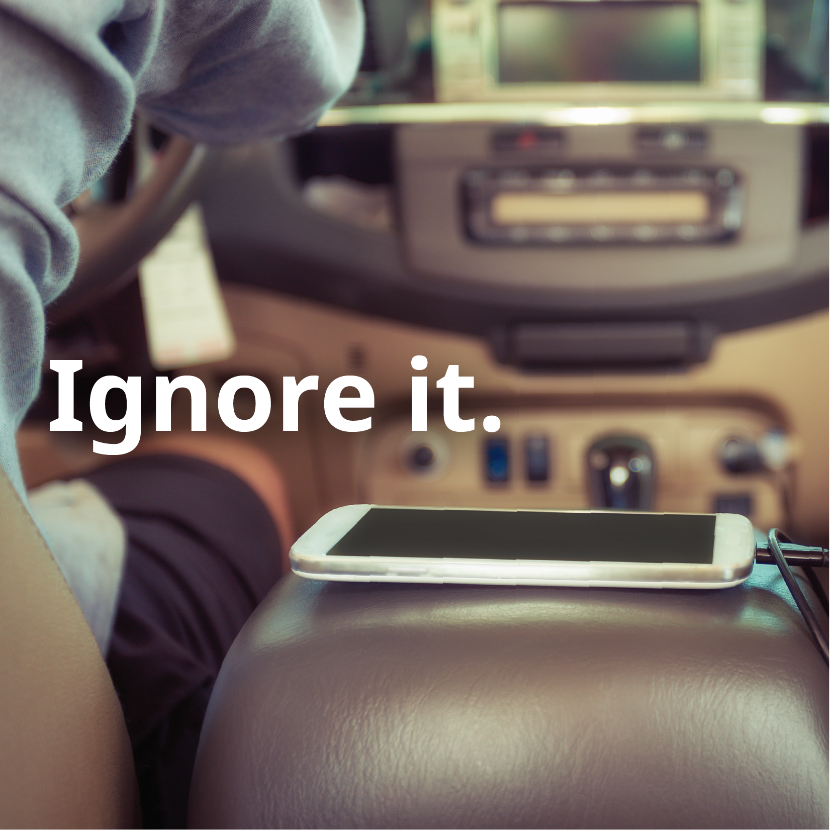

You get a text while driving.
Do you read it or ignore it?
Notes:
Instructor Notes:
Pose the question then click to show the answer options. Remind students to answer honestly. If your students do not drive yet, ask them to answer based on how they expect they would respond when they do start driving.
By clicking again, show which responses receive the H and E tally mark as noted below.
Read it = H
Ignore it = E
Direct students to update their tally marks.
Poll students to see how many responded with each choice (optional).

Slide 6


Do you ever plan to buy a lottery ticket?
Notes:
Instructor Notes:
Let students know this is the final question and that it likely requires them to think about the future since in most states you must be 18 to purchase lottery tickets.
Pose the question then click to show the answer options.
By clicking again, show which responses receive the H and E tally mark as noted below.
Yes = H
No = E
Direct students to update their tally marks.
Poll students to see how many responded with each choice (optional).

Slide 7


Are you a
or an
?
Notes:
Instructor Notes:
Direct students to total their H and E responses. Use this time to do the same on your tally of class responses if you chose to poll after every question.
Inform students that the H responses are representative of what behavioral economics would call the “Human” response while E’s are representative of the “Econ” response.
Ask students to raise their hand if they had 3 or more H responses. Do the same for those with 3 or more E responses.

Slide 8
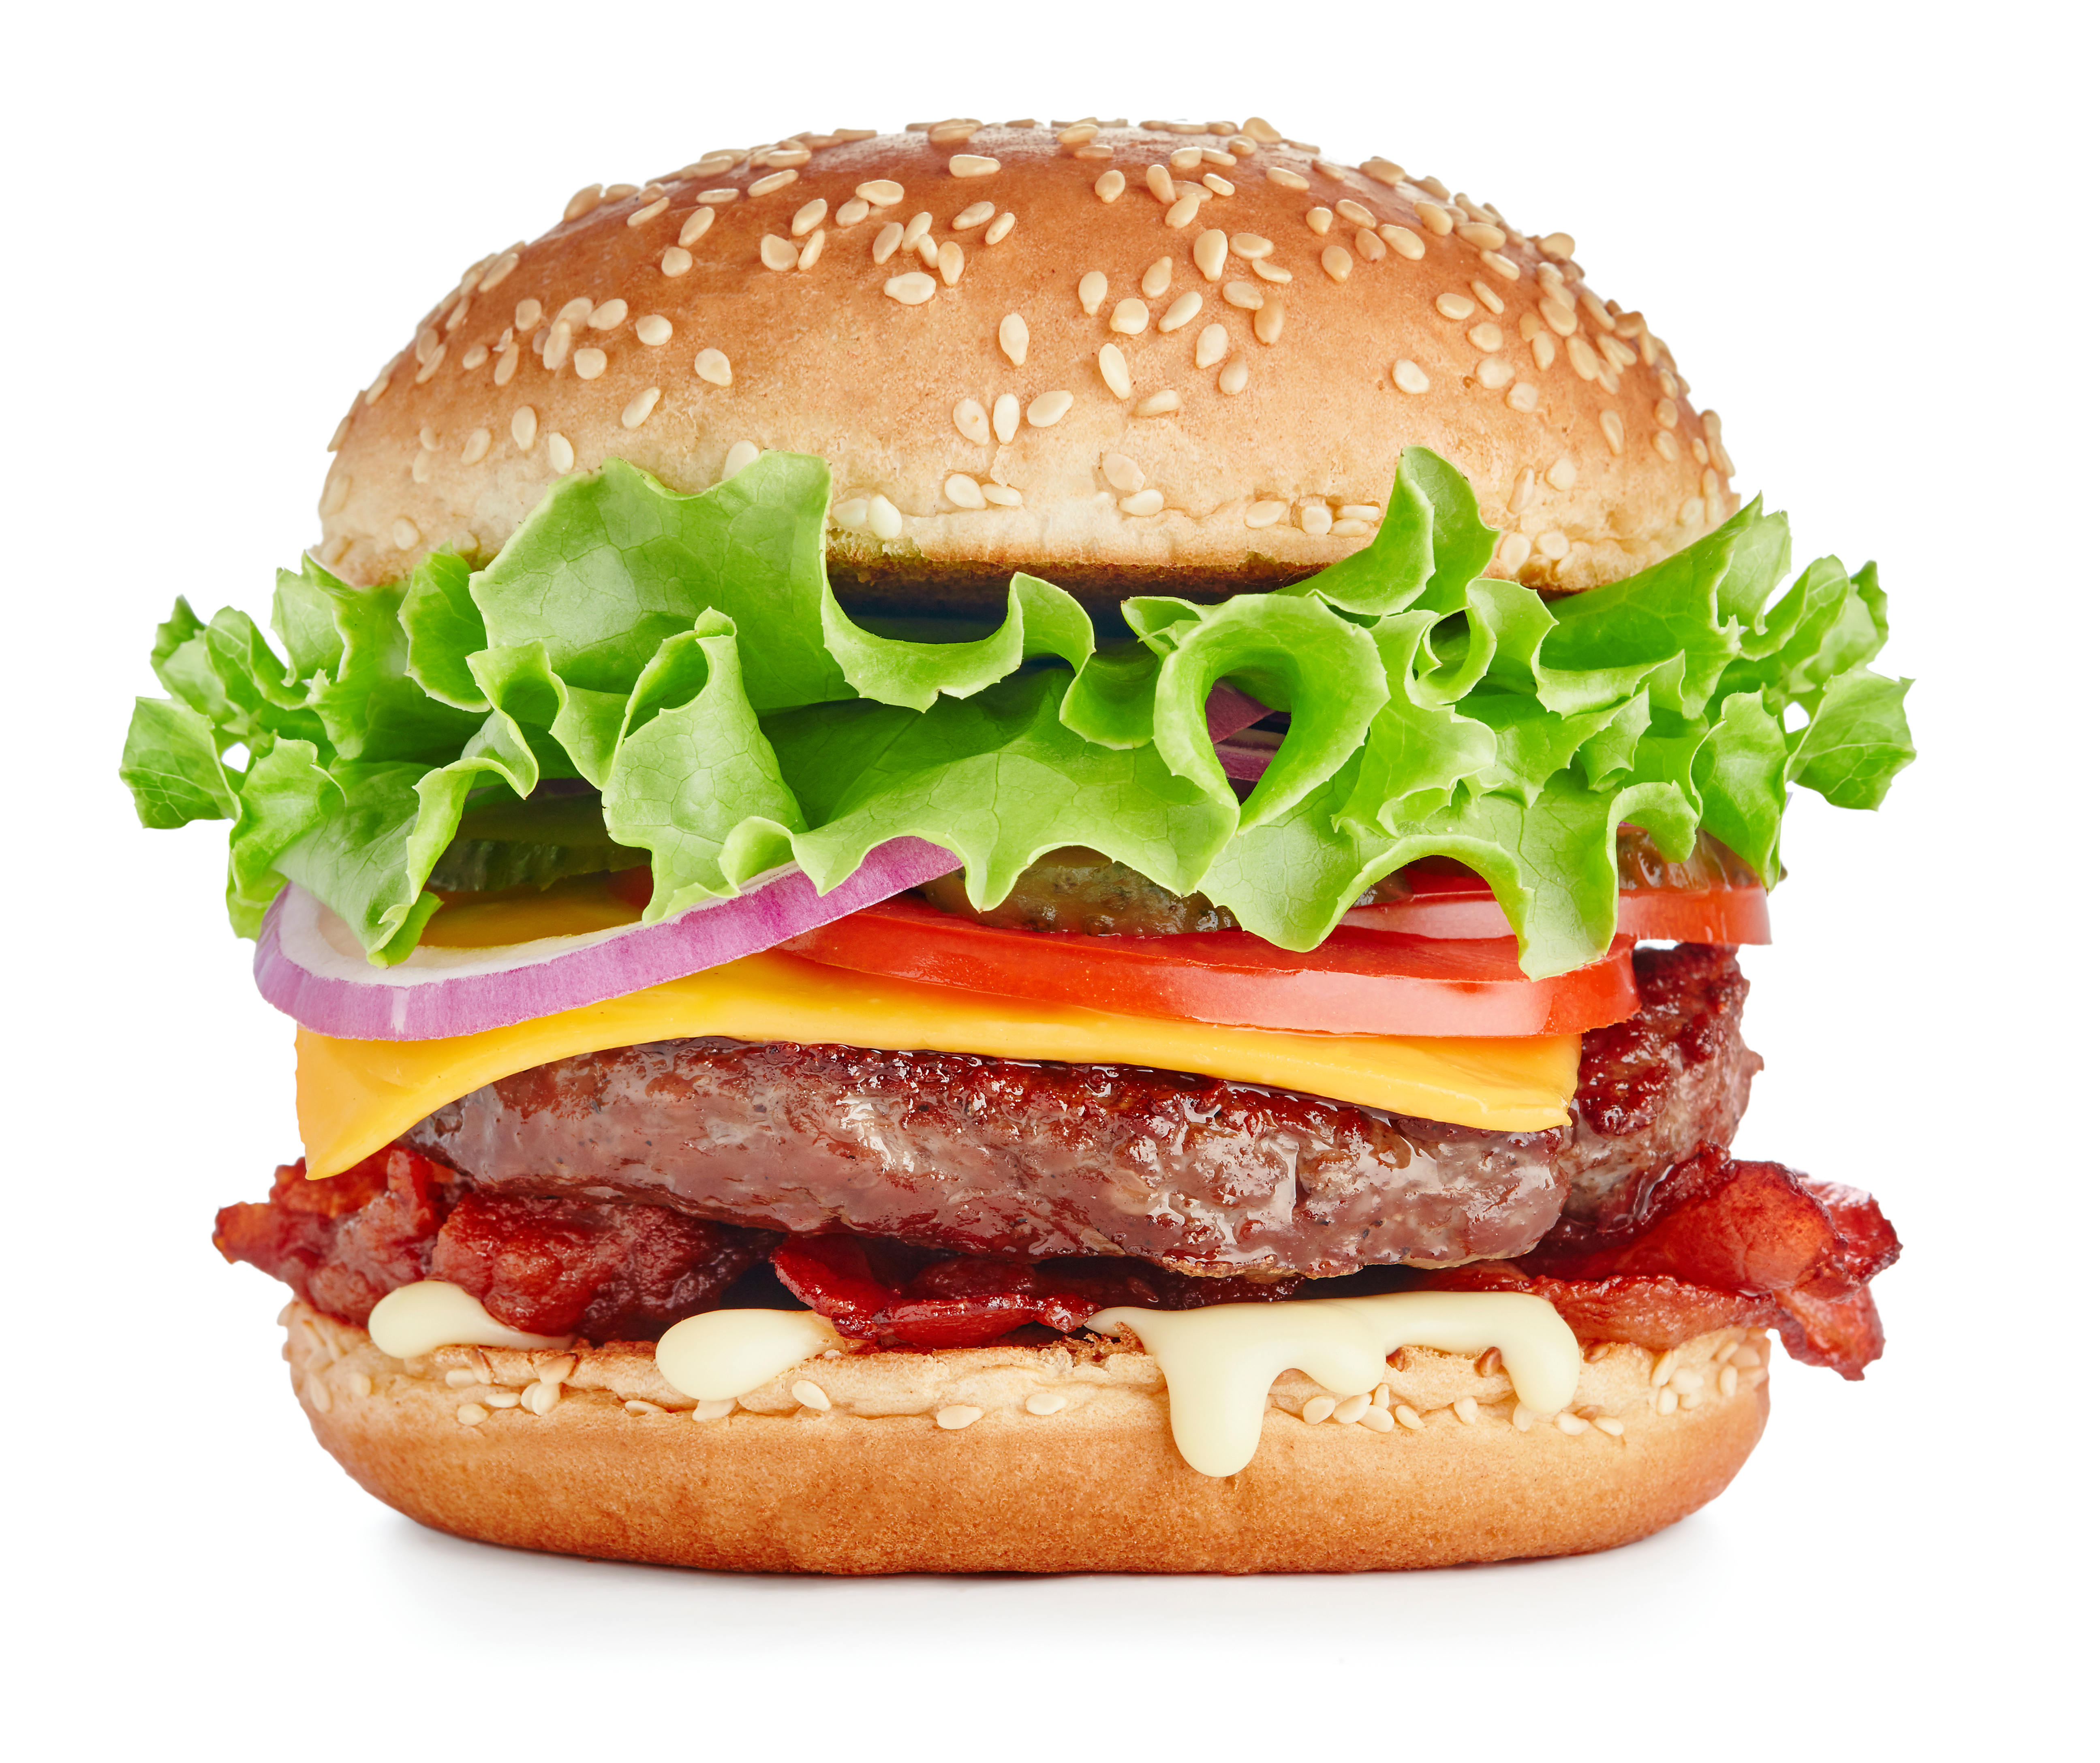
Behavioral Economics: Humans
Automatic system
Unconscious
Fast
Effortless
Gut reaction
Often irrational
Notes:
Instructor Notes:
Explain what behavioral economists mean when they refer to a “human” response.
Let students know that people often respond to situations or choice with what is called their automatic system. When we talk about “going with your gut reaction,” this is your automatic response.
Click to show students the photo of a bacon cheeseburger.
Ask students if they have ever seen someone eating something and all of a sudden wanted the same thing. This is an example of an automatic response. You didn’t want the item to begin with, but you do now that you’ve seen it.
Share that human responses are often irrational ones.

Slide 9
Behavioral Economics: Econs
Reflective system
Controlled
Self-aware
Slow
Effortful
Rule following
Always rational
Notes:
Instructor Notes:
Explain that, in contrast to humans, econs act much more rationally. They use what is called their reflective system, which is controlled, self-aware, slow, effortful, and rule following.
Ask students how they think someone acting as an “econ” would approach the same bacon cheeseburger or another desirable food item. Responses might address the following:
Is the person already hungry?
Do they like the food?
Is it healthy or nourishing?
Do they have the money to buy that food?
What other meals or snacks do they have planned?

Slide 10
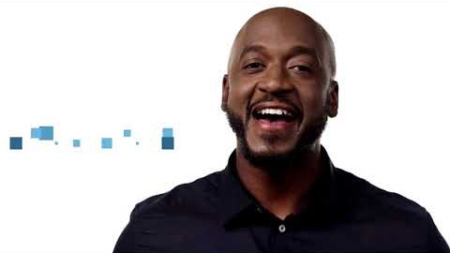
Intro to Behavioral Economics
Notes:
Instructor Notes:
Play video.
Revisit a selection of the scenarios from slides 2 through 6. Challenge students to explain how various responses represented either a human or econ response.

Slide 11
A Quick Math Quiz
A bat and a ball cost $1.10. The bat costs $1.00 more than the ball. How much does the ball cost?
If it takes 5 machines 5 minutes to make 5 widgets, how long would it take 100 machines to make 100 widgets?
In a lake, there is a patch of lily pads. Every day, the patch doubles in size. If it takes 48 days for the patch to cover the entire lake, how long would it take for the patch to cover half of the lake?
Notes:
Instructor Notes:
Let students know you are going to do one more activity to help determine if they are humans, econs, or a mix of each, but this time with a short three question math quiz.
Direct students to note their answers on a piece of paper or electronic document.
Click to reveal the questions and give the following instructions: “Here are several problems that vary in difficulty. Try to answer as many as you can. As soon as you are done, flip over your piece of paper or close your device.”

Slide 12
 | Human (automatic) | Econ (reflective)
A bat and a ball cost $1.10. The bat costs $1.00 more than the ball. How much does the ball cost? | 10 cents | 5 cents
If it takes 5 machines 5 minutes to make 5 widgets, how long would it take 100 machines to make 100 widgets? | 100 minutes | 5 minutes
In a lake, there is a patch of lily pads. Every day, the patch doubles in size. If it takes 48 days for the patch to cover the entire lake, how long would it take for the patch to cover half of the lake? | 24 days | 47 days
Notes:
Instructor Notes:
Display the answers given by humans and econs. Ask students which they think are the correct answers (answer: the econ responses) and why (answer: because people that gave these answers took their time and completed the entire program rather than giving their gut, incorrect response).
Inform students that these same questions have been answered by thousands of people and is called the Cognitive Reflection Test. It was developed by a Yale professor, Shane Frederick. Even students at very selective colleges (MIT, Yale, Harvard, and Princeton) frequently miss these questions.
Ask students to consider how this “test” supports the idea that behavioral economics might be more reliable than traditional economic theory. (Answer: With this quiz, many students give the first, quick, automatic answer. They do not take the time to fully work out the problem (i.e. writing it down, checking to see if the answer they provide makes sense, etc.). Traditional economic theory assumes that people would take these steps, but behavioral economics takes into consideration that people do not approach every decision logically. )
Challenge students to consider how this test might be adjusted to account for other factors that behavioral economists consider such as the impact other people can have on an individual’s decisions. If students struggle to answer, provide the following prompts:
Do you think your answers would have been different if:
I had asked everyone to come to the front of the class and write your answer on the board?
You had been given the wrong answer and then asked to say if it was right or wrong?

Slide 13
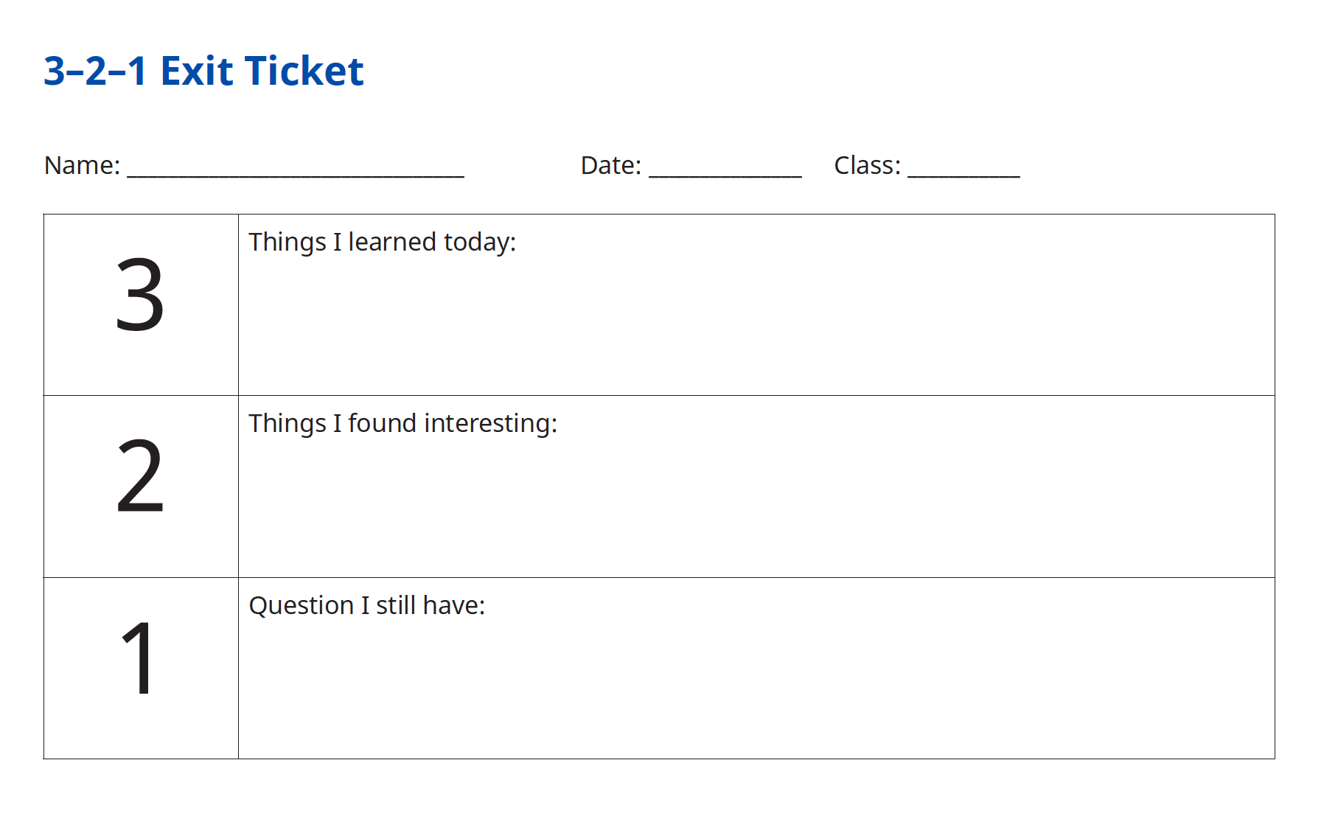
Notes:
Instructor Notes:
Invite students to complete a 3-2-1 Exit Slip. This will help students summarize their learning and comprehension of the lesson.
After the lesson, review the students’ 3-2-1 Exit Slips and determine if there are any questions that need to be addressed in the next session as well as areas of student interest for further study.

Slide 14
Activity | Think Like an Economist
In your small groups:
Read and discuss your assigned scenario.
Predict how people would respond from two points of view:
Traditional economist
Behavioral economist
Be prepared to share your responses and key points from your discussion.
Notes:
Instructor Notes:
Briefly review the key takeaways from session 1 and take a few moments to address any questions or misconceptions that were noted in your review of the 3-2-1 Exit Slips.
Inform students that economists frequently perform experiments to determine how people respond to a specific situation or choice. Tell students they will be working in small groups and making predictions about how people would respond in a specific situation or experiment.
Divide students into small groups of two to three students and distribute a copy of Think Like an Economist to each student. Determine which groups will consider each scenario. It is okay for more than one group to examine a given experiment.
Allow time for students to read and discuss their experiment and make predictions.
Invite students to pair with another small group to compare their scenarios and predictions. Encourage students to confirm or supportively challenge the other group on their predictions.
While students work, hang each of the Behavioral Economics Theories around the room.

Slide 15
Behavioral Economics Theories
There are four behavioral economics theories hung around
the room.
Gallery Walk:
Read each description.
Match each theory to a scenario from
Think Like an Economist.
Notes:
Instructor Notes:
Let students know that each of the Behavioral Economic Theories hung around the room depicts one or more theories from behavioral economics.
Invite students to take a “gallery walk” around the room, reading each description. Challenge them to match the theory to the scenarios from Think Like an Economist and note the theory or theories in the margins next to each scenario.

Slide 16
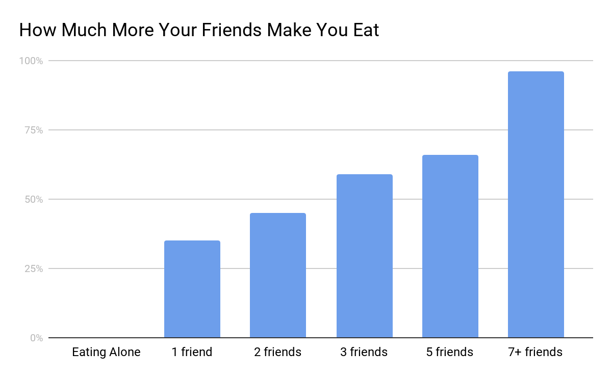
Scenario 1: A person goes out to eat with one of their friends. Do you think that person will eat more than usual, less than usual, or about the same? What if they are in a group of five people? How about nine?
Theory: HERDING
Notes:
Instructor Notes:
Ask students whose groups had this scenario to share their predictions and a highlight of their discussion.
Click to display the behavioral economics theory: herding
Ask how many students correctly identified the theory for this scenario.
Click to display the graph. Discuss why people might eat more when additional people are with them.
Challenge students to consider how knowing this information might influence someone who is trying to lose weight.
(Note: Herding is explored in even greater detail in another lesson.)
Source: Experiment by John DeCastro as described in Mindless Eating by Brian Wankink, Ph.D. (Bantam Dell, 2006)

Slide 17

Scenario 2: For years a company has offered an optional 401K retirement program. About 45% of employees regularly contribute a portion of their earnings. The company changes the program and now enrolls all employees automatically. Employees can now “opt out” if they don’t want to participate. After a year, do you think more people are investing, less, or about the same?
Theory: STATUS QUO BIAS
Notes:
Instructor Notes:
Share with students how traditional economic theory explains retirement savings. It is assumed that people will calculate how much money they will need in retirement, how long they expect to need that money, and then save enough over time to live comfortably when they stop earning a regular income.
In reality, many people do not save as often or as much as they feel they should for retirement. In most cases when presented with the choice to “opt- out” of a retirement plan rather than an “opt-in” version, more people will end up saving.
Click to reveal Status Quo Bias as the behavioral economic theory behind this scenario.
Ask students if any are familiar with Newton’s 1st Law of Physics, in particular, the portion that says an object at rest will remain at rest. Challenge students to compare the Status Quo Bias and Newton’s 1st Law.
(Note: The theory of decision paralysis is also at play in this scenario. It will be explored in another lesson.)
Source: Adapted from Nudge: improving Decisions about Health, Wealth, and Happiness by Richard H. Thaler and Cass R. Sunstein (Penguin Group, 2009)

Slide 18

Scenario 3: A family buys $100 in weekend passes to a nearby indoor waterpark. Then—out of the blue—they win a free package at an even nicer park. BUT—they find out they can only use the passes on the same weekend. Which park do they go to—the one that costs $100 or the one with free tickets?
Theory: SUNK COST FALLACY
Notes:
Instructor Notes:
Ask students whose groups had this scenario to share their predictions and a highlight of their discussion.
Click to display the behavioral economics theory: Sunk Costs. Discuss how this theory applies to the scenario.
Challenge students to describe a time they have been influenced by sunk costs in the past or a situation in which sunk costs might influence them in the future.
(Note: The theories of loss aversion and anchoring is also at play in this scenario. Each will be explored in future lessons.)
Source: Adapted from an experiment by Hal Arkes and Catherine Blumer as described in Dollars and Sense by Dan Ariely and Jeff Kreisler (Harper Collins, 2017)

Slide 19

Scenario 4: You are at a basketball game and your favorite player is having a great game. He’s made the last 10 shots he’s attempted. Your friend says he can’t keep it up. He bets you dinner after the game that the player will miss the next shot. Do you take the bet?
Theory: MISPERCEPTION OF RANDOMNESS
Notes:
Instructor Notes:
Ask students whose groups had this scenario to share their predictions and a highlight of their discussion.
For students unfamiliar with this sports example, explain that this scenario describes what is often called the “hot-hand theory.” The premise is that a player who has made numerous shots will continue to do so.
Share that this has been disproven, however, in a variety of experiments.
Compare the phenomenon to one with which students may be more familiar — flipping pennies. Some people have a hard time believing that the odds of a coin landing on tails after landing on heads three times in a row is still 50% or 1 in 2. The past event doesn’t influence the current one.
Click to display the behavioral economics theory: Misconception of Randomness. Discuss how this applies to the scenario.
Source: Experiments by Conley, Gilkovich, and Koehler as described in Nudge: improving Decisions about Health, Wealth, and Happiness by Richard H. Thaler and Cass R. Sunstein (Penguin Group, 2009)

Slide 20

Activity | Create It
Create a scenario based on one of the four theories presented.
Be ready to share and/or offer feedback on the ideas
of other students.
Notes:
Instructor Notes:
Challenge students to create a scenario based on one of the four theories presented.
Allow time for students to develop and/or write down their scenario.
Encourage students to share their scenarios while other students offer opinions on how they predict people will respond.

Slide 21
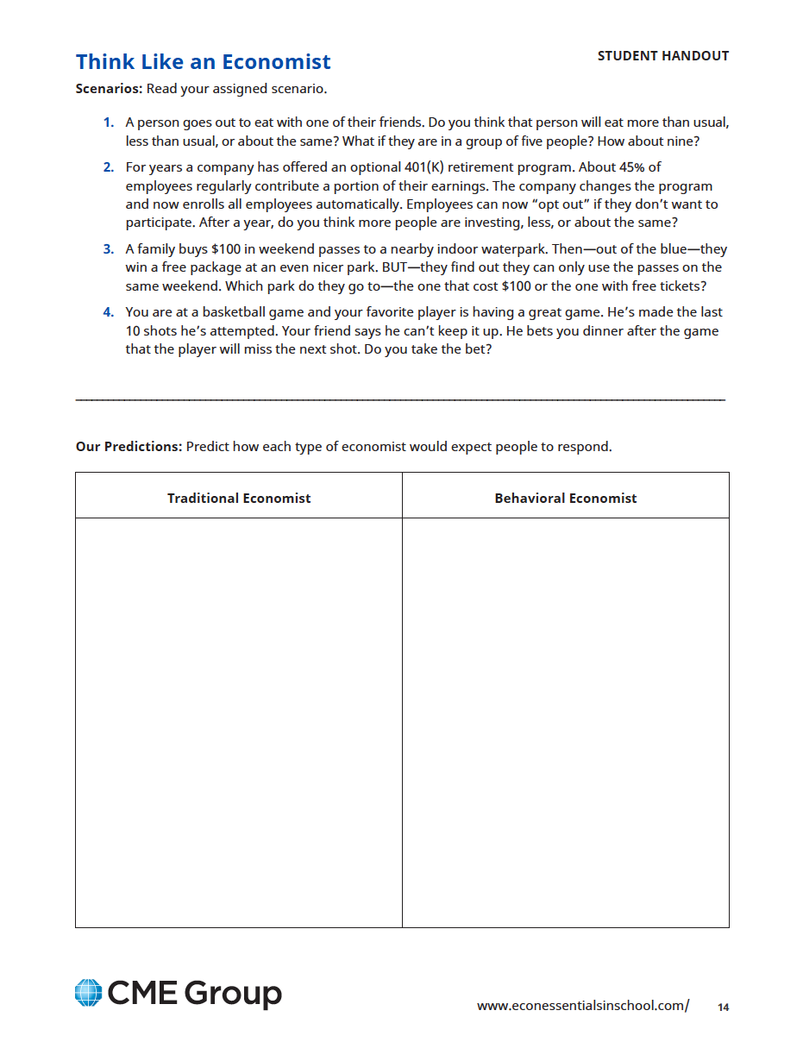
Activity | Behavioral Economics at Work
Watch each video
Brainstorm ways that behavioral economics—or people’s irrational decision making—could impact the career
Consider these questions:
  Would this career be necessary if people made rational decisions?
  Does irrational decision making influence the number of people needed to do this job?
  What decisions do people in this job face that could be made rationally or irrationally?
Notes:
Instructor Notes:
Introduce the Behavioral Economics at Work activity. Decide if students will work independently or in small groups to brainstorm and share this with the class.

Slide 22

Career and Technical Education Teacher
Notes:
Instructor Notes:
The number of jobs available for career and technical education teachers is directly related to the number of students choosing to take such classes as most career and technical education courses are often electives.
Some students may not choose these courses because they are not the “status quo” (math, English, science, social studies, etc.).
For many years, there has been a push for more students to pursue college even when many students graduate with tremendous amounts of debt or choose majors that limit their job options. Shifts in what is considered the popular choice may influence if people take these courses.

Slide 23
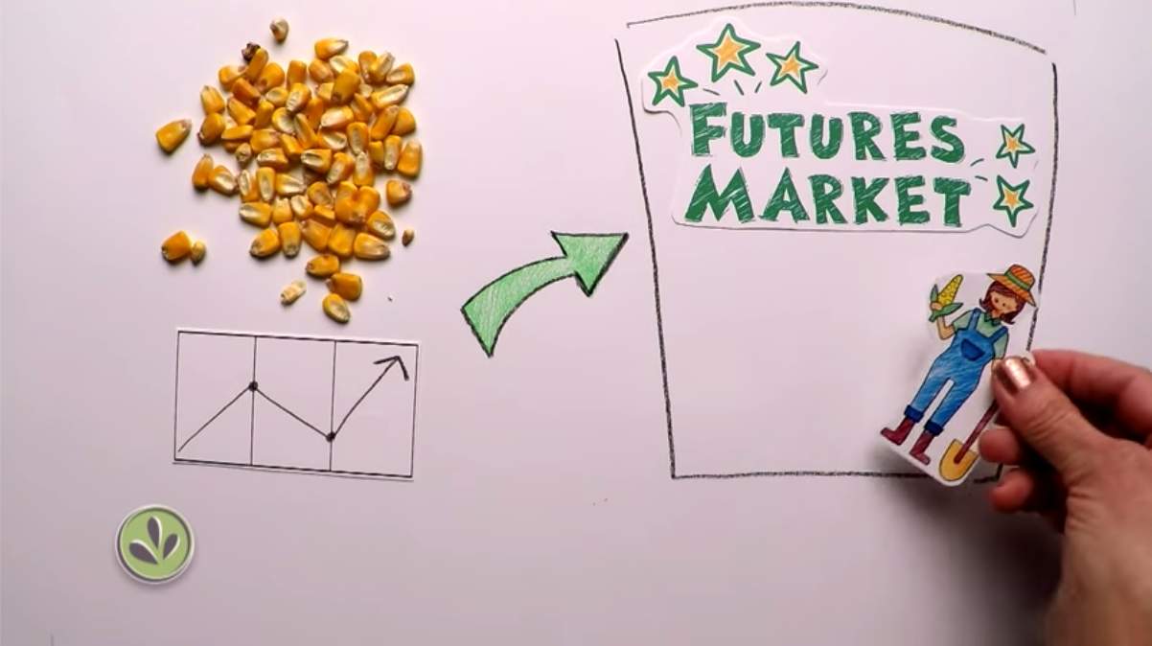
Farmers and Ranchers
Futures
Spotlight
Notes:
Instructor Notes:
Explain to students that exchanges like the CME Group bring together all kinds of people from around the world looking to manage their risk. Hedging is one type of trading that allows market participants to lock in a price now for a commodity at a later date, ultimately offsetting their price risk.
Farmers and ranchers come to exchanges like the CME Group to work with something called futures to hedge help business and individuals lock in a future price for their commodity(ies). Hedgers like farmers and ranchers can sell a “futures contract” on the crops or livestock they want to sell to protect themselves from unpredictable declines in price before their product is ready to come to market. In other words, he/she trades futures to drive risk out of his/her business.
Farmers and ranchers may have a tie to or oversee their family business, which can lead them to make more decisions based on emotion.
Students will learn in subsequent Digital Lesson Bundles about the endowment effect which suggests that people overvalue what they own. This means that In this instance, farmers and ranchers who produce their own goods may place a high value on their hard work and as a result may be reluctant to have a hard time selling at lower prices as a result.

Slide 24
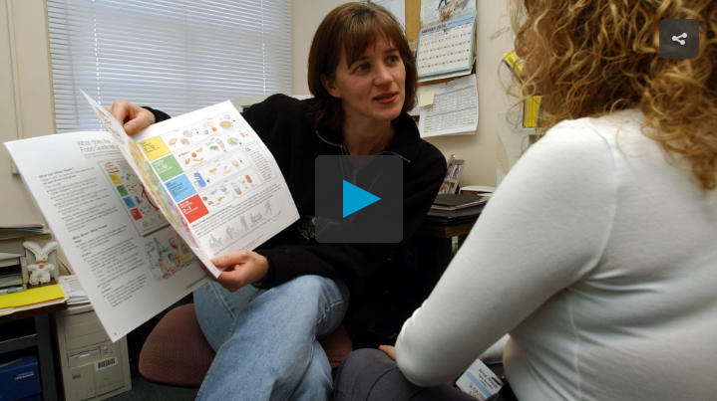
Dietician
Notes:
Instructor Notes:
One role of a dietician is helping people to make rational choices about what they eat. An understanding of behavioral economics could help people do their job better.
If everyone made rational decisions about their diets and lived healthy lifestyles, there would likely be less demand for dieticians.

Slide 25
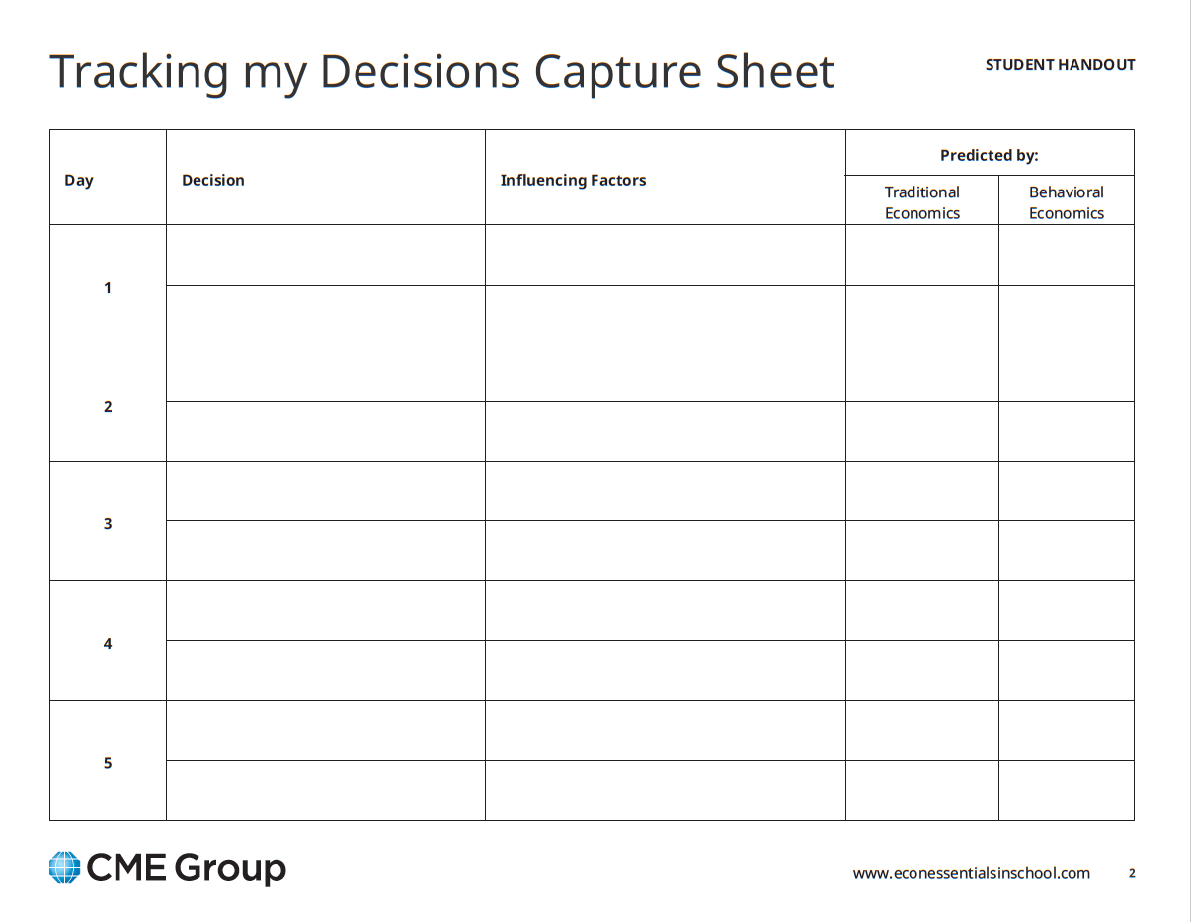
Challenge: How Rational Are My Choices?
Write down two economic decisions you make each
four of the next five days
Consider the factors influencing each
Categorize each as being predicted by traditional or behavioral economics
Be prepared to discuss your results in class
Notes:
Instructor Notes:
Distribute a copy of How Rational Are My Choices? Challenge Activity to each student.
Inform students that they will be tracking economic decisions they make over the course of five days.
Invite students to record two decisions per day on the Tracking My Decisions capture sheet (included in the challenge activity).
Challenge students to consider each decision, identify the factors which influenced each one, and then record whether or not they believe it was more in line with traditional economic decision making or behavioral economics.
Let students know when they will be expected to complete the assignment and discuss their results.

Slide 26

Reflect: How Rational Are My Choices?
In small groups:
Discuss the decisions
you made.
Consider whether thinking about why you made some of these decisions will influence your future choices?
Why or why not?
Notes:
Instructor Notes:
Invite students to form small groups and share at least two decisions they recorded on their Tracking My Decisions capture sheet.
Lead a class discussion about the process of writing down and considering their decisions. Do they believe thinking about why they made some of these decisions will influence future choices? Why or why not?

