Slide 1
Experiments in Behavioral Economics

Slide 2
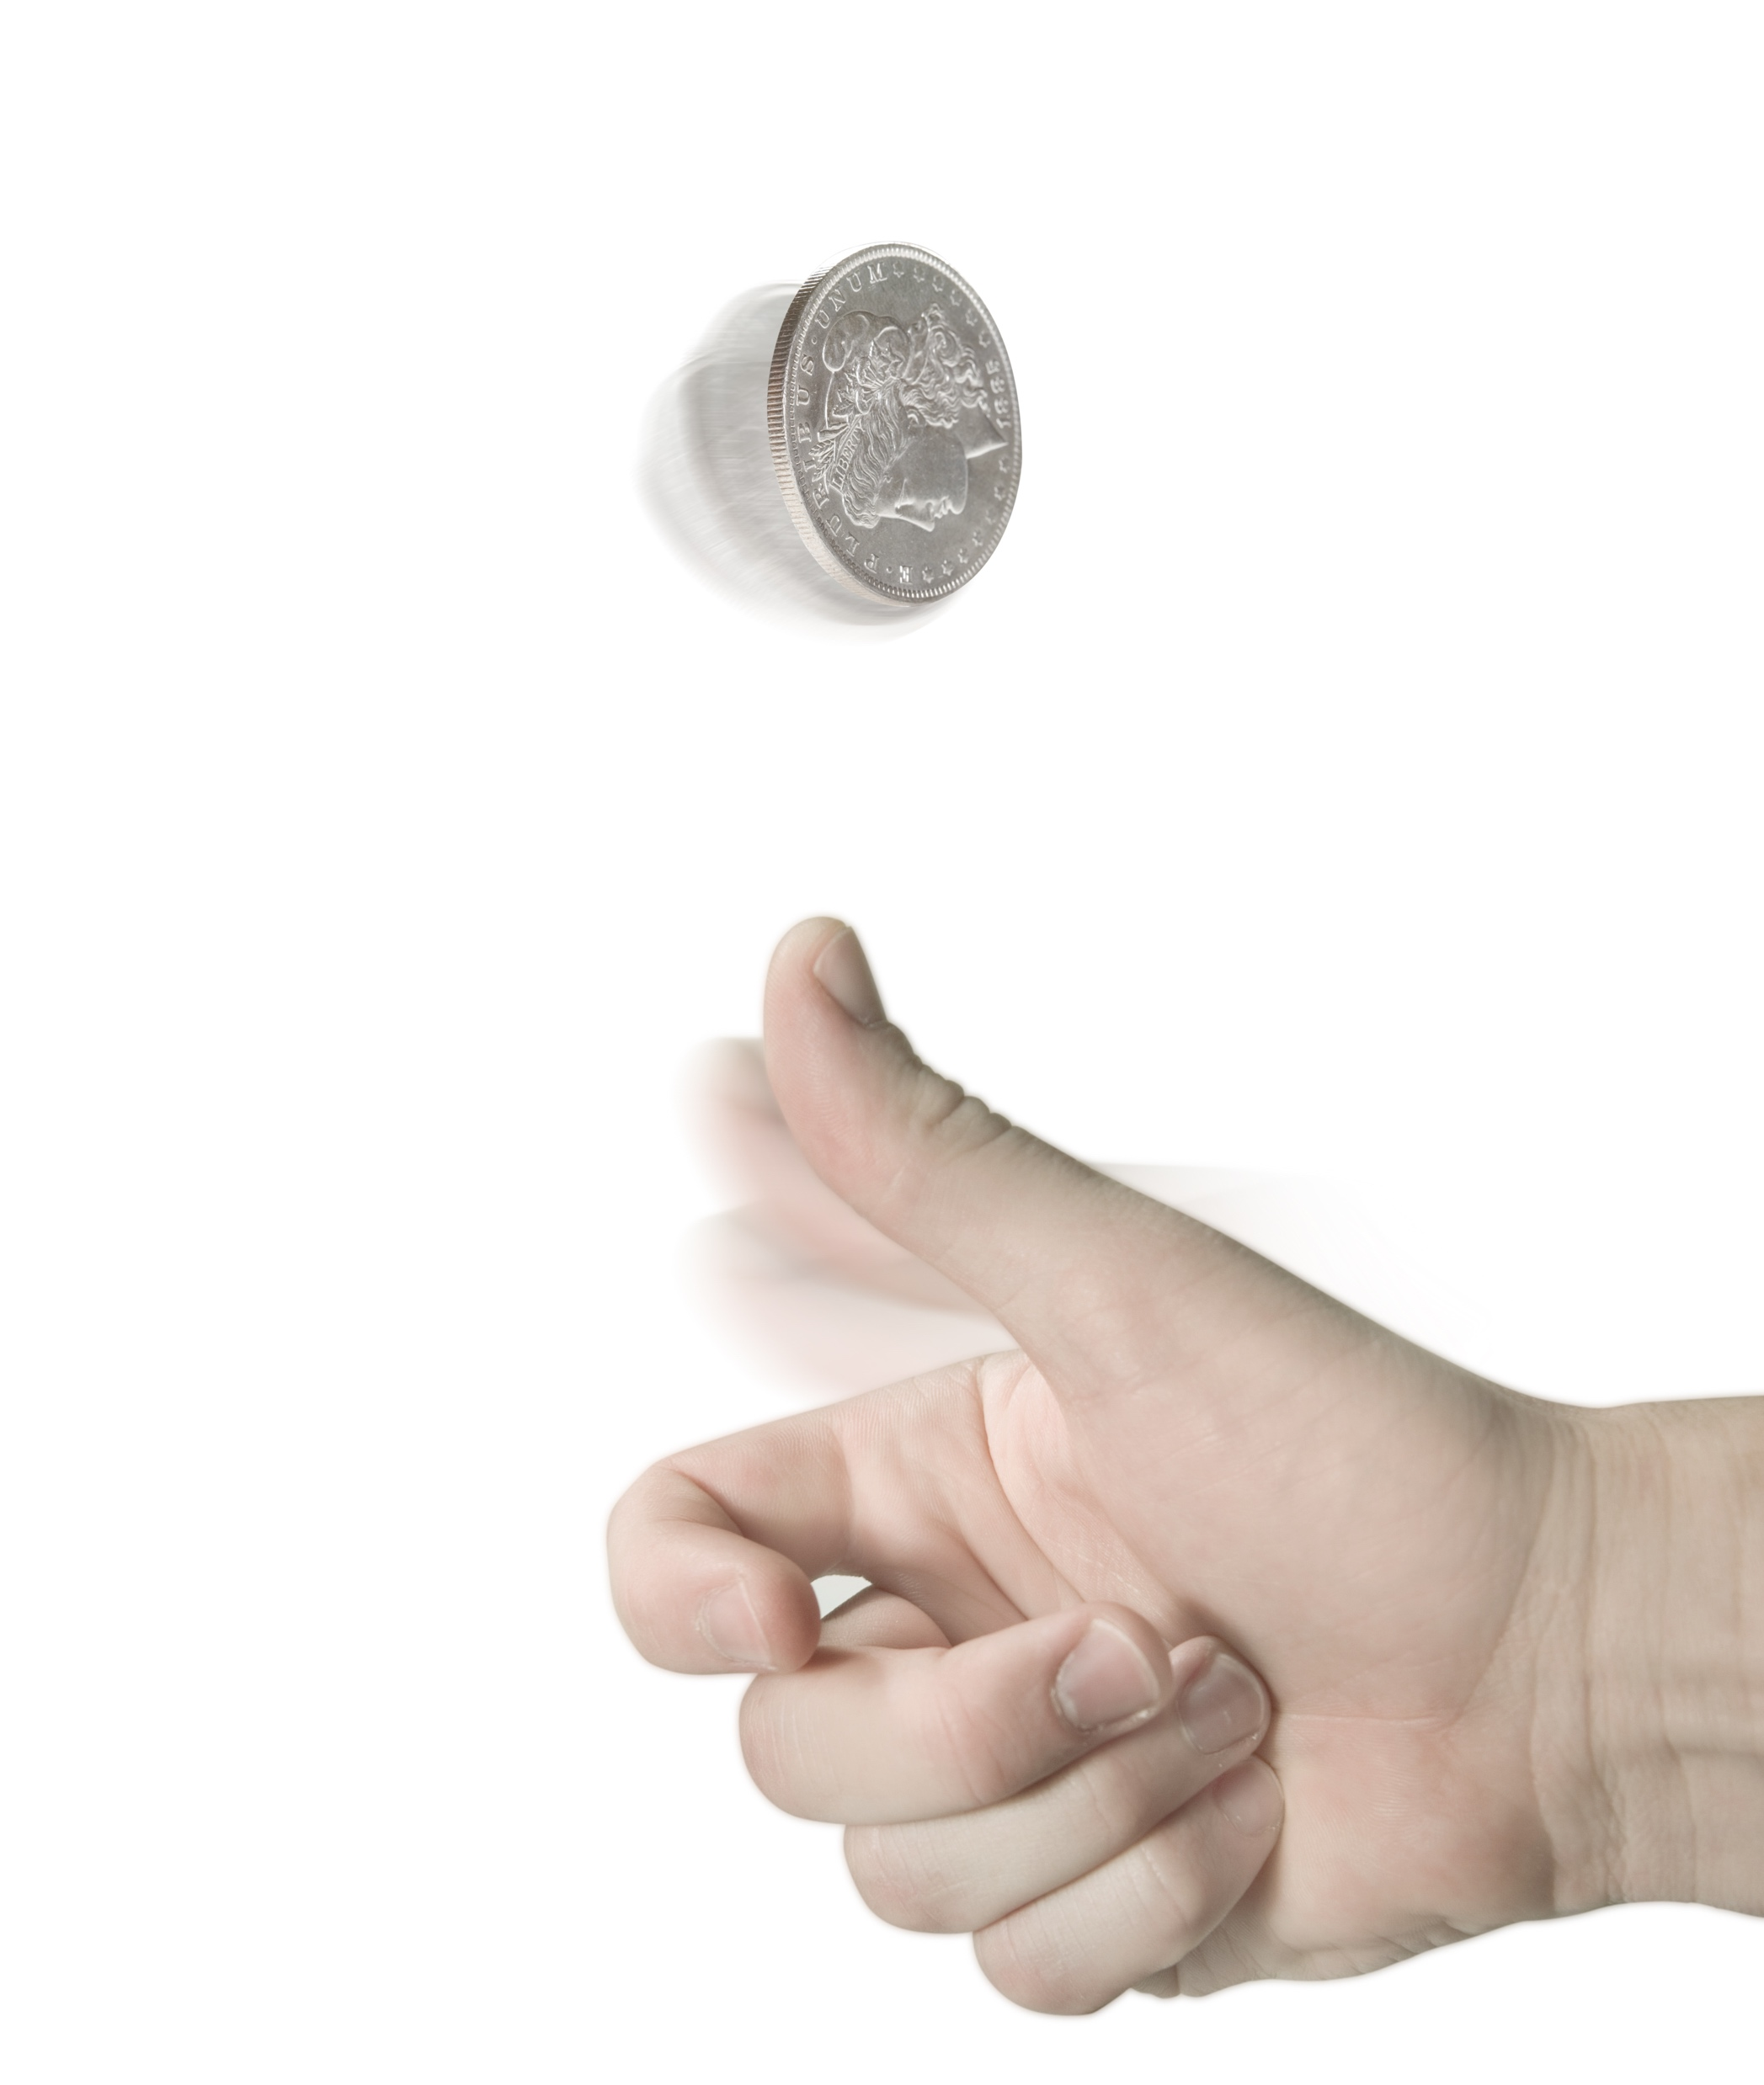
Scenario: Your friend asks you to take a bet on whether or not a coin will land on heads or tails. If it lands on heads, you will win $X. If tails, you lose $10.
Question: What does X need to be in order for you to agree to the bet?
Notes:
Instructor Notes
Tell students that the first experiment has to do with betting on a coin flip. Ask students if they agree that the odds of getting heads or tails is equal or “50/50.”
Read the scenario aloud followed by the question.
Direct students to write down their responses on scrap paper.
Ask for a student to volunteer to calculate the class’ average response either by hand, with a calculator, or using a spreadsheet. Pass all responses to that student and allow him or her time to calculate the average. Ask the student to hang on to the answer until later in the activity.
While the student is calculating, proceed to the second experiment.

Slide 3
Scenario: Since you were ten years old, your grandmother has sent you a check for $50 on each birthday. This year you open the card and find a $10 bill.
Question: How would you feel?
Notes:
Instructor Notes
Read the scenario and question aloud to the class.
Direct students to respond to the question using three words or less and make a note of their responses.

Slide 4
1
Happy.
2
Okay.
3
Annoyed.
4
Mad.
“I have $10 more than I did yesterday.”
“I wish it was the usual $50, but $10 is better than nothing.”
“It is usually $50. Why would she only send $10 this year?”
“I was counting on the $50 and knew just how I was going to use it.”
Notes:
Instructor Notes
Ask students to review the example answers shown and select the one that most closely matches what they wrote down.
Count the number of students who gave each response and calculate the average using the table below, if desired.
Discuss and compare student responses. Were students more likely to provide a positive response to the scenario (1-happy or 2-okay) or a negative response (3-annoyed or 4-mad)?

Slide 5
Scenario: Your friend asks you to take a bet on whether or not a coin will land on heads or tails. If it lands on heads, you will win $X. If tails, you lose $10.
Average for X: $20
Notes:
Instructor Notes
Inform students that it is time to revisit the first experiment.
Ask the volunteer to share the class average and compare it to the one shown on the screen, $20.
Explain that this is an experiment that one of the founders of behavioral economics, a professor named Daniel Kahneman, has done with many students. Even if he changes the amount (for example from $10 to $100 or even $1,000), the average for X is usually twice the amount given for a loss with tails.

Slide 6
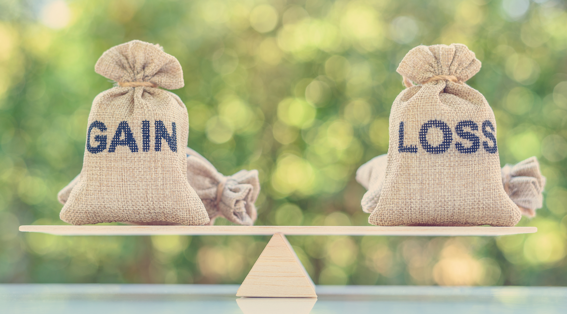
Loss Aversion
People try to prevent losses more than they try to make gains
Notes:
Instructor Notes
Share with students that the experiments they just participated in are ones that behavioral economists use to explain the notion of loss aversion: that people try to prevent losses more than they try to make gains.
Challenge students to explain how each of the experiments tie to the idea of loss aversion.
Sample answers:
People feel the loss of the expected $40 from their grandmother more than they do the gain of the $10 gift.
Even when the odds of gaining are equal to losing, people want the gain to be much more than the loss to offset the potential difference.

Slide 7
Notes:
Instructor Notes
Play the video.
Invite students to give an example of a time when they might have been influenced by loss aversion.

Slide 8
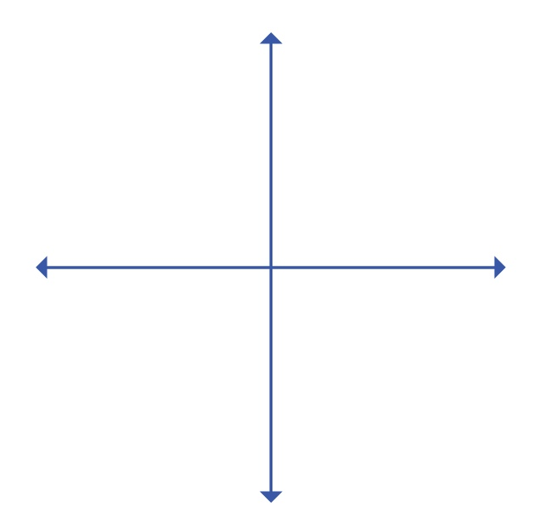
Activity | Graphing Gains and Losses
Happiness
Losses
Gains
Sadness
Notes:
Instructor Notes
Inform students that—like traditional economists—behavioral economists have been able to take what they have learned through experiments and develop graphs that demonstrate how people typically respond when given various choices or scenarios.
Show students the blank graph and explain each axis.
X-axis: Represents the amount of money a person gains or loses.
Y-axis: Represents how a person feels (happy or sad) about the gain or loss.
Divide students into small groups and distribute a copy of Graphing Gains and Losses to each student.
Direct each group to create a graph which they believe shows the relationship between the two variables (money and feelings). Let students know that their graph does not need to be a straight line, it may include one or more curves.
Advise students that they should be prepared to share their graph with the class and explain how they decided on the curve they drew.
Allow time for each group to discuss the relationship between the variables and decide on a graph.
Invite each group to share their graphs. Compare and contrast the responses. Are any similar? Do any standout as being very different?

Slide 9
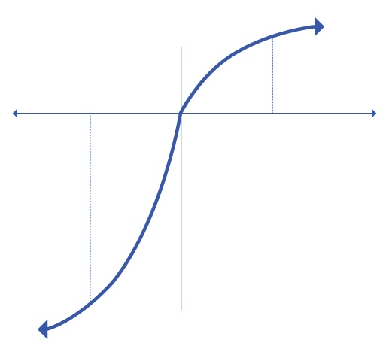
Kahneman and Tversky’s Value Function
More
utility
People like gains…
$100
loss
Losses
Gains
$100
gain
…but they
hate losses
more.
Less
utility
Source: Misbehaving: The Making of Behavioral Economics, Richard H. Thaler
Notes:
Instructor Notes
Let students know that the graph shown is a version of the one they just created. It was developed by behavioral economists Kahneman and Tversky and is also called the “value function.”
Point out that the graph substitutes “more utility” for happiness and “less utility” for sadness, but otherwise the idea is the same. Through their experiments and those of others, they proposed that people feel losses much more than they do gains. As pointed out in the video, losses impact people twice as much as gains do. On the graph, this is represented by the steep slope or curve on the left side of the graph versus the more gradual slope or curve on the right side of the graph.
Call attention to how a $100 gain on the graph results in half as much of a change in utility as a $100 loss.
Invite students to consider the sentence on the graph, “People like gains...but they hate losses more.” Challenge students to put this saying into their own words and provide a real-world example of this taking place and/or influencing a person’s decision.

Slide 10
“But I Have Experiments”
Notes:
Instructor Notes
Remind students that in the first session they learned about loss aversion and participated in short experiments to demonstrate its effect.
Play the video.

Slide 11
Take a Stand
Behavioral economics is more accurate because it has evidence from experiments to back up its claims.
Agree? Disagree?
Notes:
Instructor Notes
Read the statement on the slide.
Tell students to stand up and move to one side of the room if they agree with the statement and another side if they disagree with the statement.
Call on students from each side to explain their position. If no students stand on one side, move to that side and argue for that position yourself.
Let students know that the behavioral economist shown on the right in the video is Professor Ariely. The book in his hand is one that he wrote, Predictably Irrational. He has written several books on behavioral economics.
Ask if anyone wishes to reconsider and move based on what they heard from classmates or the knowledge that the person in the video had a vested interest in making the case for behavioral economics. If students move, ask them why they repositioned themselves. What specifically changed their minds?

Slide 12
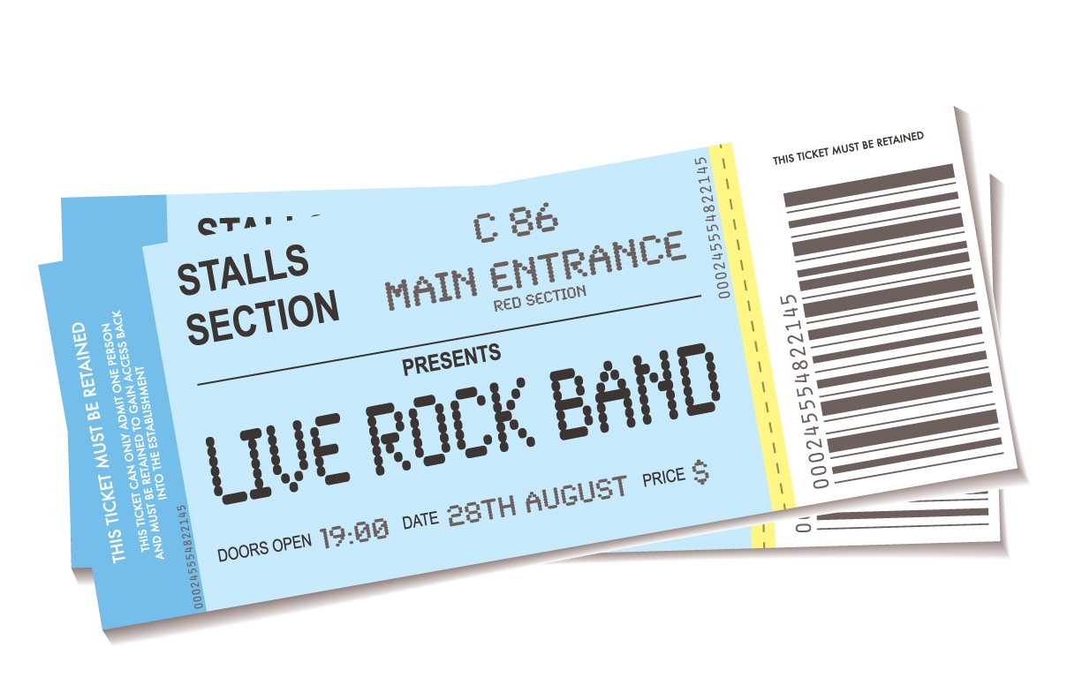
Imagine This…
You save up $200 to purchase tickets to see your favorite band or singer in concert. You get great seats. You hear that people are now offering to pay $2,000 for tickets like yours.
Notes:
Instructor Notes
Inform students that you are going to consider additional experiments from behavioral economics and see if their opinions are reinforced or changed as a result.
Read the scenario.
Ask students how a traditional economist would expect people to respond.
Answer: Since you can make $1,800 in profit by selling the ticket, a traditional economist would expect you to sell it and forgo the experience which has no economic or financial value.
Challenge students to brainstorm a list of factors that people might consider when making the decision. Examples might include the ability to experience the concert in person, the stories they will be able to tell, the photos they will have to remember the event, how else they could use the $1,800 if they sell the tickets, the potential to disappoint friends if they don’t go with them, etc.

Slide 13
Basketball and Economics
Notes:
Instructor Notes
Tell students that an experiment was done by behavioral economists that was similar to the one they are considering.
Ask if any students follow college basketball. In particular, are any familiar with “March Madness”—when the NCAA’s best men’s basketball teams compete in a bracket-style tournament to decide the “best” team in the country? Call on a student to briefly describe how the tournament works. It is a single elimination tournament which narrows from 64 to 32 to 16 (“sweet sixteen”) to 8 (“elite eight”) to 4 (“final four”) to 2 (championship game) to 1 (champion).
Let students know that the behavioral economist in the video they just saw is a professor named Dan Ariely at Duke University whose men’s basketball team plays in the tournament almost every year and has won it numerous times.

Slide 14
Ticket Lottery
Lottery Winners (Have a Ticket)
How much would someone have to pay you to sell your ticket?
Lottery Losers (Don’t Have a Ticket)
How much would you pay someone to buy his or her ticket to the game?
$2,000
$100
Notes:
Instructor Notes
Let students know that Professor Ariely often used students from the university as test subjects for his experiments.
Explain that one such experiment involved tickets to Duke basketball games. One year when students could only receive tickets to a very important end-of-season game through a lottery, Professor Ariely and his team asked students that won tickets how much they would be willing to sell them for and asked students who didn’t win tickets how much they would be willing to pay to get a ticket.
Ask students to guess what the average response was for each group.
Click to show the average responses.
Let students know that when Professor Ariely and his team asked people to explain their answers these were some of the reasons people gave:
Lottery winners/sellers: The game was going to be a defining moment in their college career. They were so excited to go that it was almost “priceless.” The amount someone would have to pay them would have to be very high to offset the disappointment of not being able to go.
Lottery losers/buyers: They had already resigned themselves to the fact they weren’t going to the game. They could watch the game on tv with other students and fans. They had other things they wanted to do with their money.

Slide 15
Endowment Effect
People overvalue things they own
The Mug Experiment
Two groups:
Buyers
Sellers
Notes:
Instructor Notes
Explain that this phenomenon is what behavioral economists call the endowment effect, which says that people overvalue things they own.
Click once. Share that one of the most famous experiments related to the endowment effect has to do with a coffee mug.
Click again. Explain that students at a university were recruited to participate in an experiment. Half were given a mug and asked how much they would be willing to sell the mug for. The other half were asked how much they would pay to get a mug.

Slide 16
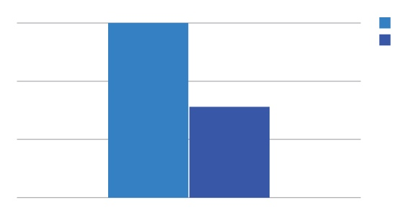
The Mug Experiment
6
Sellers
Buyers
4
US Dollars ($)
2
0
Price
Notes:
Instructor Notes
Let students know that versions of this experiment have been done over and over again with many different people and with different variables. Nonetheless, the outcome is almost always the same. People who are given the mug and asked to sell it almost always value it twice as much as the people who are asked to buy it.

Slide 17
Kahneman and Tversky’s Value Function
More
utility
People like gains…
$100
loss
Losses
Gains
$100
gain
…but they
hate losses
more.
Less
utility
Source: Misbehaving: The Making of Behavioral Economics, Richard H. Thaler
Notes:
Instructor Notes
Revisit the value function graph. Direct students to explain how the graph can be used to explain the endowment effect.
Sample answer: The previous bar graph showed that people who were selling the mug would value it twice as much as those who didn’t have one. This is similar to the value function because the pain of losing it or selling it is twice as much as the buyer’s happiness would be if they purchased it.

Slide 18
Activity | Be the Economist
Create an experiment that can be used to test whether or not the endowment effect exists and/or how strong it is with people.
Notes:
Instructor Notes
Challenge students to create their own experiment which could be used to determine if people think rationally or are influenced by ownership of an item. Students may work in pairs, small groups, or independently.
Ask students to share their ideas.
Discuss the importance of conducting experiments that are fair and unbiased. Ask students if they can make connections to what they have learned in science or math classes about setting up experiments and/or collecting and analyzing the data.

Slide 19
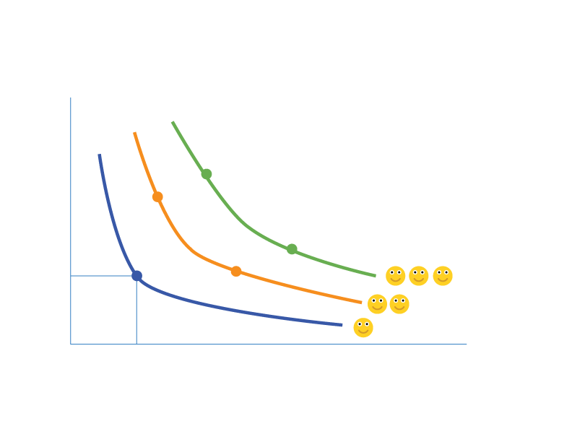
An Indifference Map
D
B
Income (dollars per year)
E
C
A
Leisure (vacation days per year)
Notes:
Instructor Notes
Tell students that a graph such as the one shown appears in almost all traditional economic textbooks. It is what is called an “indifference map” with each curve called an “indifference curve.”
Point out that the graph plots income (measured in dollars per year) against leisure (measured in days per year). Another way to think about leisure is that it is time spent not working.
Explain that traditional economics supports the idea that people will find all points on one of the curves to be equally desirable.
Click to show the label for point A. Let students know that this represents a combination of income and leisure that people are content to have. Not just that, they would be equally content with any other point or combination of income and leisure time along the blue curve. In other words, they would be indifferent—hence the name of the curves, indifference curves.
Tell students that the orange and green curves are indifference curves for the same person. Ask students what they think the orange and green curves represent.
Click again to show the smiley faces. Explain that the blue curve represents combinations that would make a person somewhat happy, combinations on the orange curve would make a person happier, and the green would make the person even happier.
Click a third time to show points B, C, D, and E. Check for understanding by asking the following:
If a person had a combination of income and leisure at point B, would you expect them to be more or less happy with the combination at point C? Answer: Neither. You would expect them to be equally content or indifferent.
If a person went from point A to point B, what would you expect? Answer: They would be happier.
If a person went from point D to point C, what would you expect? Answer: They would be less happy.
Let students know that behavioral economists find fault with indifference curves and maps because of loss aversion and the endowment effect. Ask students to explain why they think that is.

Slide 20
An Indifference Map
Brady
$50,000
Income (dollars per year)
Carly
$40,000
10
20
Leisure (vacation days per year)
Notes:
Instructor Notes
Direct students to focus on just two points, B and C. Tell them that Brady’s income and leisure time are represented by point B and Carly’s by point C.
Click to show specific amounts for income and leisure.
Ask students to imagine that Brady was offered the opportunity to switch places with Carly. What factors might he consider? What if Carly was offered the opportunity to switch places with Brady?
Challenge students to consider how behavioral economists might approach this issue knowing what they do about loss aversion and the endowment effect.
Sample Answers: Brady feels ownership of the money or income he has. Loss aversion tells us that he will feel twice as bad about losing it as he would about gaining leisure time or days off. Similarly, Carly would feel half as happy to gain income as she would to lose days off.

Slide 21
Activity | Find the Connection
Determine how loss aversion and/or the endowment effect impacts a situation.
Notes:
Instructor Notes
Let students know that they will be considering how loss aversion and the endowment effect can impact real people’s finances by discussing one of several scenarios.
Divide students into small groups. Give each group a scenario to consider from Find the Connection.
Let students know how much time they will have to discuss their scenario and how you expect them to share their situation and findings with the rest of the class when they are done.

Slide 22
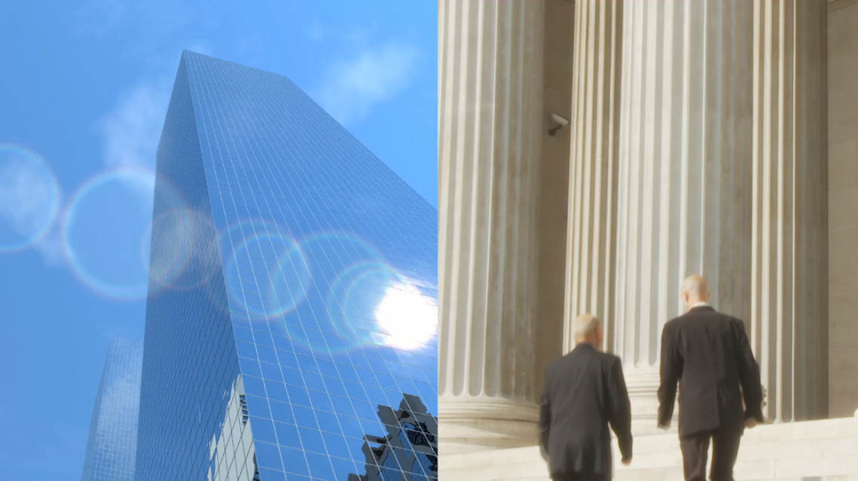
Speculator
Futures
Spotlight
An individual who accepts price risk in hopes of profiting from buying and selling futures contracts.
Notes:
Instructor Notes
Direct students to return to their seats.
Remind students that they learned about hedgers in the previous lesson (people who avoid risk, such as farmers and ranchers, by locking in the price of a commodity at a later date).
Ask students if a marketplace could exist if everyone in it was a hedger. Guide students to understand that hedgers need someone to buy the commodity and absorb the price risk they are looking to avoid. These individuals are called speculators. The two go hand-in-hand and bring balance to the market.
Click once to reveal the definition of a speculator and read it to the class.
Click again to reveal the video link, and play the video, Hedging and Speculating.
Distribute the Hedger or Speculator? Quiz. Challenge students to differentiate between hedgers and speculators by answering each question. Review answers with students.
Facilitate a discussion in which you encourage students to apply their understanding of loss aversion and the endowment effect to the role speculators and hedgers play in futures markets.
Note: If needed to enforce understanding, provide students with the “Who is a Speculator” handout found at the following link for additional examples of speculators: https://www.futuresfundamentals.org/content/themes/futures-fundamentals-responsive/assets_imported_from_prototype/pdf/Who_is_a_Speculator.pdf

Slide 23
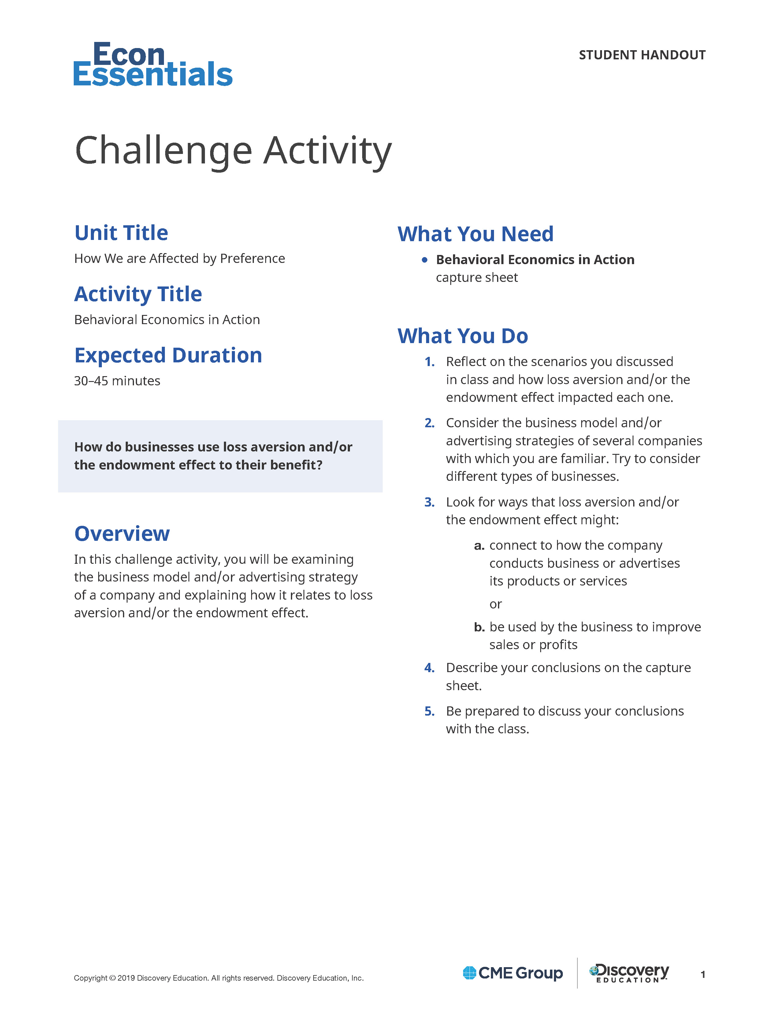
Challenge | Behavioral Economics in Action
Consider a business you understand and/or shop from.
Does it use loss aversion or the endowment effect to impact customers or sales?
How could it increase profits by further leveraging these concepts?
Be prepared to discuss your results in class.
Notes:
Instructor Notes
Distribute a copy of the Behavioral Economics in Action Challenge Activity to each student.
Inform students that they will be considering businesses with which they are already familiar. When doing so, they should consider whether or not the businesses already use loss aversion and/or the endowment effect to impact customers or sales. Then, students will need to consider how the businesses could improve profits by using the theory of loss aversion and/or the endowment effect.
Encourage students to consider multiple types of businesses to have the opportunity to discover how loss aversion and/or the endowment effect influence a variety of industries.
Let students know when they will be expected to complete the assignment and discuss their results.

Slide 24
Reflect | Behavioral Economics in Action
In small groups:
Discuss the conclusions you made.
Consider whether knowing how businesses use these concepts could make you a smarter consumer in the future.
Notes:
Instructor Notes:
Invite students to form small groups and share the conclusions they reached and recorded on the Behavioral Economics in Action capture sheet.
Lead a class discussion about how understanding loss aversion and the endowment effect can help students make informed financial decisions in the future.

